Slide 1
Assessment of Developmental Disorders (0-6 yrs)
By: Mary Kate Bueltmann
Shelbi Burnett

Slide 2
What is a Developmental Disorder?
As defined by IDEA: Delays having to do with
1. Cognitive development
2. Physical development
3. Communication development
4. Social Emotional development
5. Adaptive development
to the point where the child needs special education and related services
A developmental disability can be any number of conditions as long as it is the result of a genetic disorder, disease, impaired growth pattern, or unknown.
Happens anytime before the age of 21 and last your whole life
Specific diagnosis required, could require extended or skilled care

Slide 3
Developmental Disorders
Autism
Cerebral Palsy
Diabetes
Downs Syndrome
Epilepsy
Fetal Alcohol Syndrome
Fragile X Syndrome
Mental Retardation
Hearing loss
Verbal difficulties
Dysphagia
Spina bifida
Spinal muscular atrophy
Hypotonia
Visual impairment

Slide 4
Global Developmental Delays (GDD)
Subset of developmental delay defined as significant delay in two or more developmental domains (reserved for children less than 5 years old)

Slide 5
Facts about Developmental Disorders
12-16% of children have a developmental and/or behavioral disorder
Only 30% are identified before school entrance
Communication between pediatricians and parents at a young age are critical

Slide 6
Activity
Think-Pair-Share: What would a child in your scenario behave like?

Slide 7
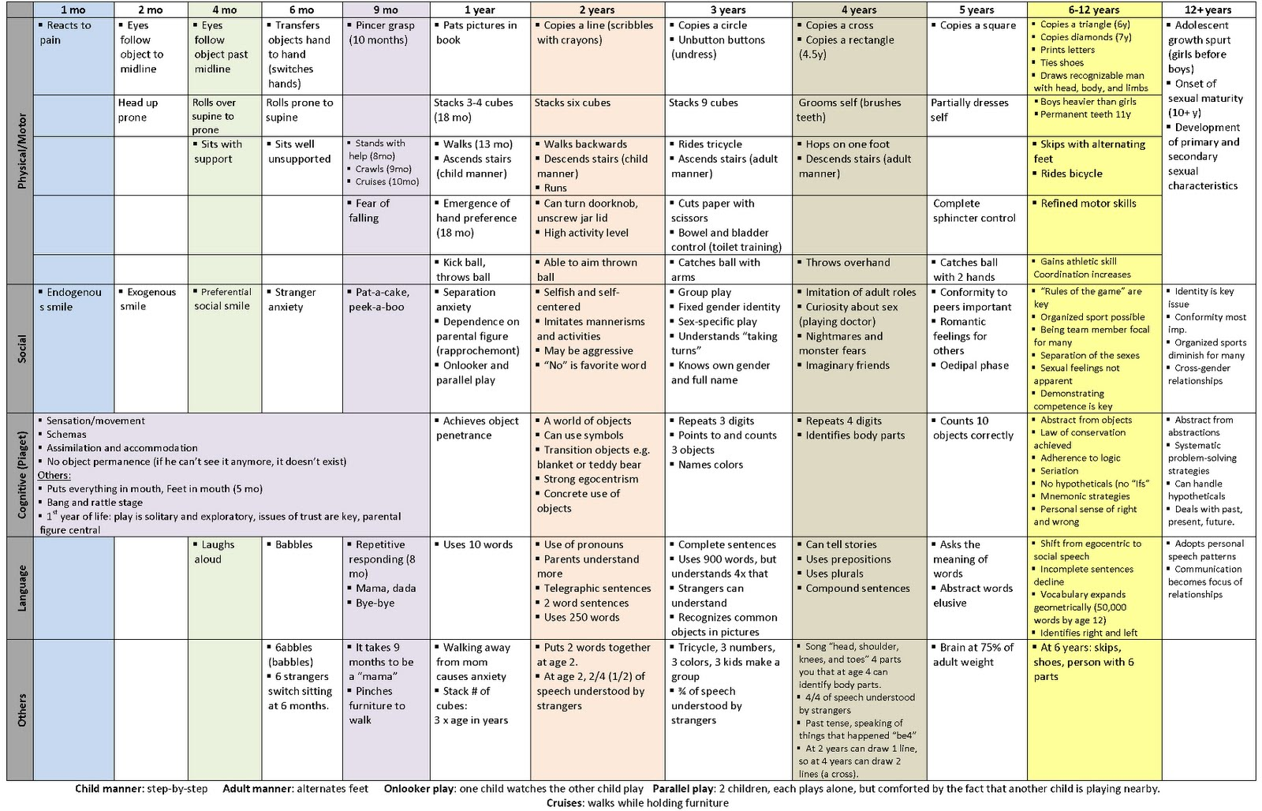
Developmental Monitoring
Notes:
9, 18, 24, 30 months -- AAP

Slide 8
Developmental Screening What happens when a child misses these milestones?
CLIP
Ages & Stages Questionnaire (ASQ)
diagram
Child Development Inventories (CDI)
Kent Inventory of Developmental Skills (KIDS)
Bayley Infant Neurodevelopmental Screener Test
Denver Developmental Screening Test II (DDST-II)
Parents Evaluation of Developmental Status (PEDS)
Batelle Developmental Inventory Screening Tests (BDIST)
Questionnaire
Multidomain and specific tests
Failure of tests result in more diagnostic evaluation and possibly early intervention services
Notes:
Asq– 15-20min, 1month-5.5 yrs,

Slide 9
Individualized Family Service Plan (IFSP)
IFSP must include the following:
PLOPS
Family information
Results expected
Early intervention services needed
When/where/how often services are provided
Who pays for services
Service Coordinator
Transition
Sample IFSP

Slide 10
IFSP vs IEP
IFSP
Includes all developmental domains
Family and child strengths/concerns, measureable outcomes, and services
Services are given in natural environment (home and places natural for the child’s age group)
Payment involved
Receive a service coordinator
Reviewed every 6 weeks
Cannot be held without family present
Year round services
IEP
Only includes academic domain
Child strengths/concerns, measurable outcomes, and services needed
Focused on least restrictive environment in classroom
No payment, covered by public school and IDEA
Service coordinator can be requested to transition child into IEP
Reviewed annually
If family is not present, school must find another way to have family participation
Only provides services during school year

Slide 11
Early Intervention Services
CLIP
Team of specialists including:
Speech/Language Therapist
Occupational Therapist
Physical Therapist
Developmental Specialist
Pediatric Nurse
Social Worker
Psychologist

Slide 12
Early Intervention Services
Screening
Developmental Assessment
Home Visits
Community Enrichment Groups
Parent Groups
Resource and Referral Information
Consultation to Community Early Childhood Programs
Opportunities for Parent Involvement
Professional Development Opportunities
Services are covered under IDEA
There is an annual fee based on annual income/family size

Slide 13
Activity – Mirror, Mirror
One person at your table will be the leader and act out one of the following actions
Washing dishes
Feeding the cat
Sweeping the floor
Dusting
Paying the bills
Cooking dinner
Setting the table
Everyone else identifies activity and imitates it

Slide 14
Conclusion
How would this activity help young children with developmental delays?

Slide 15
Sources
American Academy of Pediatrics, Committee on Children with Disabilities: Developmental Surveillance and Screening of Infants and Young Children. Pediatrics 2001; Vol 108: No.1: pp192-195
Feldman H., Developmental-Behavioral Pediatrics. Ed. Zitelli B., Atlas of Pediatric Physical Diagnosis. 2002: pp58-86.
LaRosa A., Glascoe F., Developmental surveillance and screening in primary care www.uptoddate.com.
LaRosa A., Glascoe F., Developmental and behavioral screening tests in primary care www.uptoddate.com.
Shevell M, Ashwal S, Donley D, et al. Practice parameter: Evaluation of the child with global developmental delay—report of the Quality Standards Subcommittee of the American Academy of Neurology and the Practice Committee of the Child Neurology Society. Neurology. 2003;60 :367 –380.

