Slide 1
Developing Home-Grown Talent
Mentorship Program

Slide 2
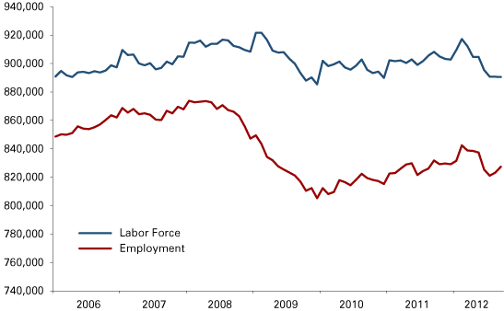
Unemployment Rate in Indianapolis= 6.1% (U.S. Bureau of Labor Statistics)
Quarter 2, 2014—more than 2700 jobs committed to the area (Indy Chamber)
(ibrc.indiana.edu)
Notes:
The problem: unemployment rates, though they are still a large problem, are decreasing in Indianapolis
because we are attracting more businesses and increasing the number of job opportunities in the area.
But who is getting those jobs? Are the jobs going to Indianapolis residents? Are the citizens of Indianapolis ready and qualified for those jobs?

Slide 3
The Question:
Are the citizens of Indianapolis ready and qualified for these jobs?
Notes:
Preparation for the future begins at an early age

Slide 4
Those without a high-quality education at an early age are…
25% more likely to drop out of school
40% more likely to become a teen parent
60% more likely to never attend college
70% more likely to be arrested for a violent crime
(United way of Central Indiana)
Notes:
Bettering one’s self with education tends to have a negative connotation in lower income neighborhoods. Kids are unmotivated by their peers and their surroundings to further their education and invest in their futures.

Slide 5
Community Mentorship Program
Our Response:
Notes:
For children and teens to link up with community leaders (from moms to local business owners), to recognize that they have and can further develop transferrable skills (communication, problem solving, teamwork, etc.), to make them knowledgeable about their opportunities in Indianapolis, and to encourage them to make and pursue career goals

Slide 6
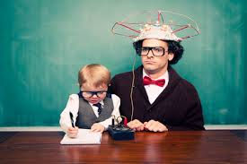
Mentors & Mentees:
Stay-at-home moms to local business owners
Easy to access Network of Mentors for help, consultation, sharing ideas
Applying avocations as well as vocations
Elementary to high school age mentees

Slide 7
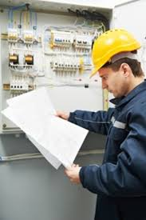
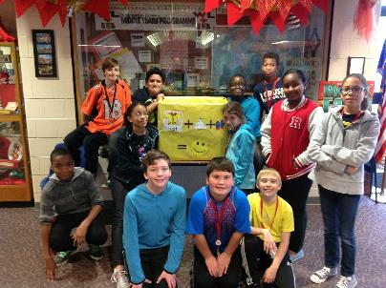
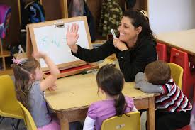
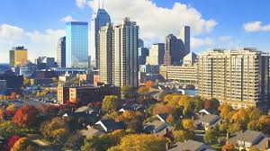
Why?
Notes:
Not only individual development, but community development
Improve education basis
Attract businesses
Generally improve quality of life in communities
More exciting place for kids to learn
Chance for community leaders to learn as well—to better their own skills and to learn about new generations in their community

Slide 9
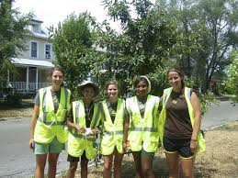
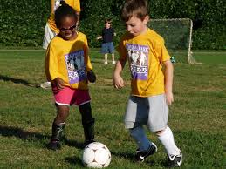
How? What we have in mind…
Mentor Starter Packet
Ideally, mentor/mentee group meetings weekly/bi-monthly
& monthly events with all mentors and mentees throughout the individual communities and/or Indianapolis
Notes:
We’ve created a sort of starter packet to help mentors get started, including team building games, problem solving techniques, and communication exercises. Ideally, mentor groups will meet up weekly or bi-monthly according to their schedules—this is flexible for each case. Also, ideally there would be monthly events for the groups to attend, whether they be planting trees with KIB, learning business skills with Lemonade Day, painting a mural with Big Car, or just playing a friendly soccer game at the park.

Slide 10
Next Steps:
ADVERTISING
&
REVISING

