Slide 1
Design Thinking
Summer Fusion 2015

Slide 2
Doug Dietz

Slide 3
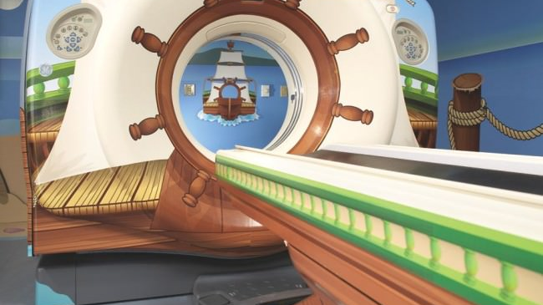
Human-centered Design

Slide 4
Empathy

Slide 5
Innovation
3 factors to balance:
people
technical
business
business
(viable)
people
(desirable)
technical
(feasible)

Slide 6
Design Thinking
Seeking the sweet spot of
desirability,
feasibility,
viability.
(Kelly & Kelly, 2013)
business
(viable)
people
(desirable)
technical
(feasible)

Slide 7
Design Thinking
3 factors to balance:
people
technical
business
business
(viable)
people
(desirable)
technical
(feasible)

Slide 8
Innovation
Fundamentals
The reading, writing, and arithmetic of innovation:
Observation
Brainstorming
Prototyping

Slide 9
Bring new ideas to life.
1. Inspiration
2. synthesis
Go into the jungle.
Be deliberate:
Plan experiences that will spark creative thinking.
Observe.
Be empathetic:
Connect with needs, desires, motivations of real people.
Recognize patterns, identify themes, find meaning.
Organize observations.
Move from concrete to abstract and more generalizable concepts.
Where are there actionable principles and ideas?

Slide 10
Bring new ideas to life.
3. ideation + experimentation
4. implementation
Brainstorm:
Generate ideas
and divergences.
Prototype:
Represent ideas in concrete ways.
Get feedback:
Let people react to your ideas.
Adapt and iterate.
Plan for roll-out/going live.
In what form will you present your ideas?
To whom?
Where?

Slide 11
Observe
Seek to understand people, their environments, their choices.

Slide 12
Brainstorm
Use brainstorming as a tool and a skill to be developed.

Slide 13
Brainstorming
7 secrets
for better
brainstorming
After-effects of brainstorming

Slide 14
What makes an effective team?

Slide 15
Innovation
Humility + Confidence
Observe with humility.
Brainstorm with confidence.
Fail with humility and confidence.

