Slide 1
Regional Dynamics in Addressing Challenges and Opportunities
Butler Summer Fusion
May 18, 2015

Slide 2
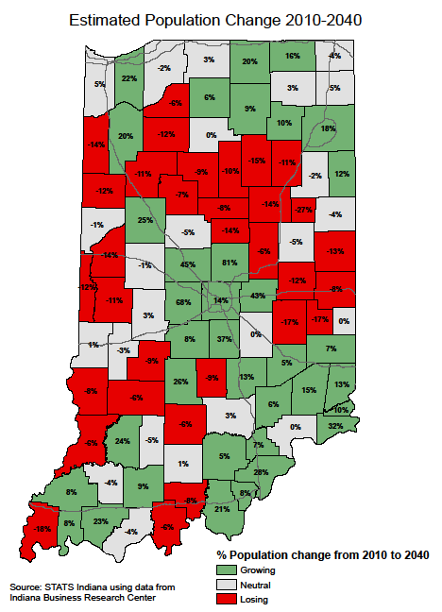
Metropolis of Indiana
Population Change 2010-2040

Slide 3
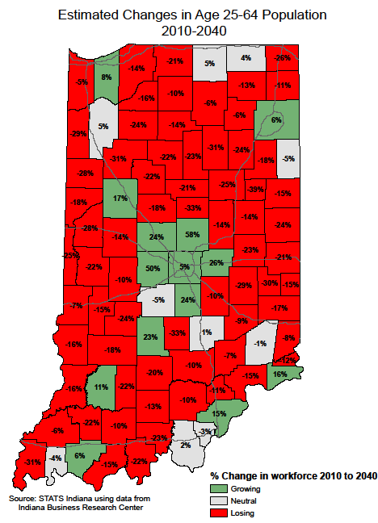
Metropolis of Indiana
Workforce Change 2010-2040

Slide 4
Metro is the Future
Stats Indiana population change 2010 to 2040
  Marion County 14%
  Metro Indianapolis (minus MC) 43%
  Other metros 10%
  Rural Indiana -2%
  Total metro from 5 million (78%) to 6m (81%)
  Rural from 1.4m (22%) to 1.3m (19%)
    56% (118,444) more seniors
    -144,643 non-seniors
Workforce (25 to 64)
  Metro Indianapolis 17%
  Other metro -2% (-34,897)
  Rural Indiana -16% -116,174

Slide 5
Metro Indiana Impact: Employment Centers
Marion County
    18% of all Indiana jobs
    24% of all wages
    Less than 2% of all land
    14% of population
Metro Indiana (not Marion County)
    63% of all jobs
    59% of all wages
    Less than 49% of all land
    64% of population

Slide 6
Strong Core = Strong Economy
Downtown Indianapolis:
4% of all Indiana jobs
    Central Indiana 31%
    Marion County 20%
$9.3 billion of investment since 1990
22 million visitors
    1,187,147 convention room nights, $3.6 billion in spending
Trend changer - attracting out of state households / retaining in-state millennials

Slide 7
Regional Job Growth
2014: Regional Population: 50/50 split
    Long-term demographic shifts
2000-2012:
    Marion County lost 41,000 jobs
    Suburban counties gained 78,000
      Marion County's regional job share fell from 73% to 65%
      205,000 Commuters into Marion County
        #1 per capita for inflow migration of workers
Source of Job Growth
Skills Mismatch
    Indianapolis MSA 46/50 for socio-economic mobility
    Early Childhood Education
    Type
    Geography
Workforce Mobility
    Transit = Workforce Mobility

Slide 8
Impact of Changes to Local Taxation
  1-2-3 Property Tax Caps
    My Slice of the Pie
      Public Safety
      Schools
        Referenda
      Infrastructure
      Amenities
    Mix of Property Types
      Job Poaching
  Reliance on Income Taxes
    Restrictions on Uses
    Equity in Revenues

Slide 9
Regional Cooperation:
  Threats: Tax Structure
    Understanding of Sources & Uses
    Acknowledge Interdependence
  Intra County Fights:
    Land-use (small/rural vs. growth)
  Competition (locally) & Collaboration (State/Nation)
  Legislative Dynamics
    Indianapolis “Gets Everything”
      Investments largely made by locals
      ROI for the State
    Us vs. Them
      Rural/Urban Divide
        Suburban Dynamic
      Polarized Delegations
    Border State Metros
      Media Markets

