Slide 1
Internship and career services
Summer Fusion
2015

Slide 2
MBTI: Learning Your preferences
Presented by:
Nicole Wilson & Jeremy Walthall

Slide 3
What is the mbti?
Created by Isabel Myers and Katharine Briggs in the 1940’s using Carl Jung’s theory
Most widely used personality inventory in the world!
More than 2M worldwide each year!
Helps you:
Identify your natural born preferences
Understand yourself, your natural strengths, and your areas for growth
Develop an appreciation of those that differ from you

Slide 4
What is the mbti?
Every person carries out two kinds of mental processes:
We take in information
Then we make decisions about the information
Jung observed that we all live in two worlds:
The outer world of things, people, and events and
The inner world of our own thoughts, feelings, and reflections
Each person has a preference for either the outer world or the inner world

Slide 5
What is the MBTI?
Extraversion E or I Introversion
Sensing S or N Intuition
Thinking T or F Feeling
Judging J or P Perceiving

Slide 6
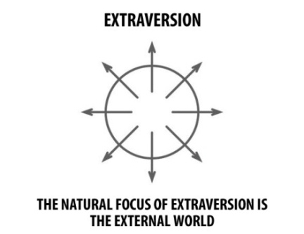
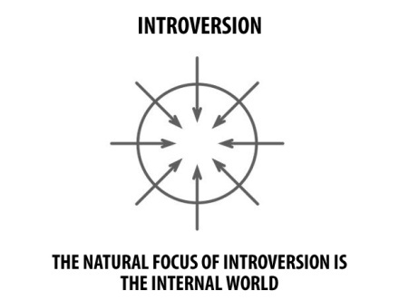
Where do you focus your attention? Where do you get your energy?
Extraversion
Focus on the outer world
Prefer to communicate face to face
Learn best through doing or discussing
Sociable
Expressive
Introversion
Focus on the inner world
Prefer to communicate in writing
Learn best by reflection
Focus in depth on interests
Private and contained

Slide 7
discussion
You are planning to attend a networking event. What type of event do you prefer and why?
e.g. Large open networking event vs. smaller scale one-on-one networking.

Slide 8
Key words: extrovert vs introvert
E I
Extraversion Introversion
Action Reflection
Outward Inward
People Privacy
Interaction Concentration
Many Few
Expressive Quiet
Do-Think-Do Think-Do-Think

Slide 9
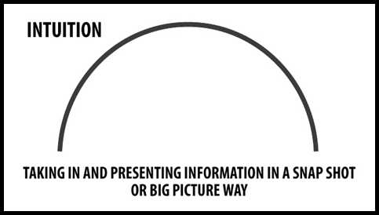
How do you prefer to take in information?
Sensing
Real and tangible
Present realities
Factual
Concrete
Observe and remember specifics
Trust experience
Specific and literal
Intuition
See the big picture
Future possibilities
Imaginative, verbally creative
Patterns and meanings
Move quickly to conclusions
Trust inspiration
Metaphors and analogies

Slide 10
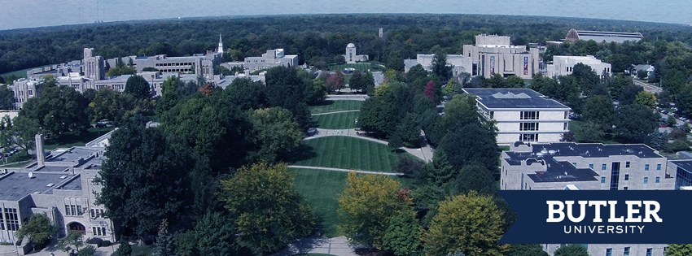
discussion
Pick a destination on campus and provide directions to your partner on how to get there.

Slide 11
Key words: sensing vs intuition
S N
Sensing Intuition
Facts Ideas
Realistic Imaginative
Specific General
Present Future
Keep Change
Practical Theoretical
What is What could be

Slide 12
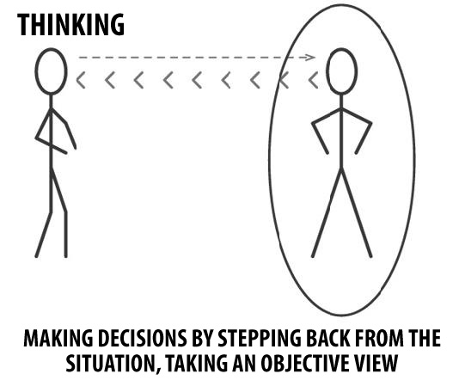
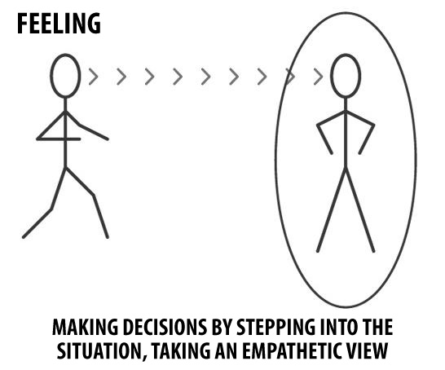
How do you make decisions?
Thinking
Analytical, logical
Cause/effect
Reasonable
“Tough minded”
Fair – wants everyone treated equally
Feeling
Empathetic, compassionate
Guided by personal values
Assess impacts of people
Strive for harmony
Fair – wants everyone treated as an individual

Slide 13
discussion
You are part of an intramural team, and there are 15 players on the team, all with good skill in the game. You are invited to a tournament, but only 10 players can attend. How do you go about selecting which players will go?

Slide 14
Key words: thinking vs feeling
T F
Thinking Feeling
Head Heart
Detached Personal
Things People
Objective Subjective
Critique Praise
Analyze Understand
Firm but fair Merciful

Slide 15
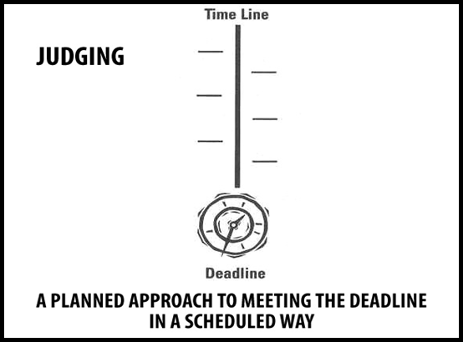
How do you deal with the outer world?
Judging
Scheduled, organized
Systematic
Methodical
Likes decisions
Tries to avoid last minute stresses
Perceiving
Spontaneous, flexible
Casual
Open-ended
Adapt, change course
Likes things open to change
Energized by last minute stresses

Slide 16
discussion
Your team is tasked with planning a community fundraiser for your organization. What is your approach to planning the event?

Slide 17
Key words: judging vs perceiving
J P
Judging Perceiving
Organized Flexible
Decision Information
Control Experience
Now Later
Closure Options
Deliberative Spontaneous
Plan Wait

Slide 18
What’s your type?
ISTJ
ISTP
ESTP
ESTJ
ISFJ
ISFP
ESFP
ESFJ
INFJ
INFP
ENFP
ENFJ
INTJ
INTP
ENTP
ENTJ

