Slide 1
Mindful Attention Awareness Scale
http://www.ppc.sas.upenn.edu/mindfulnessscale.pdf
Higher scores = more mindfulness
The benefits of being present: Why mindfulness mattershttp://selfdeterminationtheory.org/SDT/documents/2003_BrownRyan.pdf

Slide 2
Applications of Organization Theory
Summer Fusion I
May 19, 2015
Notes:
Social units with a particular purpose
Attract participants
Acquire and allocate resources to accomplish goals
Use structure to divide and coordinate activities
Rely on certain members to lead or manage others

Slide 3
Does Networking Make You Feel Dirty?
Casciaro et al., 2014, Administrative Science Quarterly

Slide 4
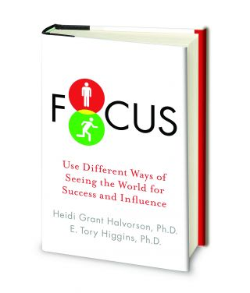
Prevention mode
Oughts, duties, obligations
Promotion mode
Growth, advancement, opportunities

Slide 5
Open Systems
Notes:
Organizations are not self-contained

Slide 6
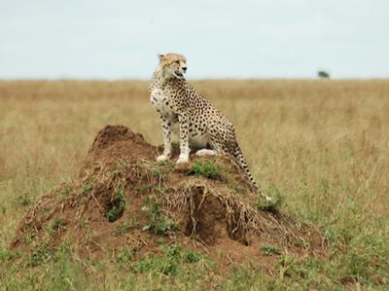
Scanning
Information gathering
Prelude to interpretation and action
What’s your scanning strategy?
(Daft & Weick, 1984)

Slide 7
Building Shared Mental Models
Team members’ shared, organized understanding & mental representation of knowledge about key elements of the team’s relevant environment (Mohammed & Dumville, 2001)

Slide 8
Complexity
Notes:
It’s all too complex for me
There’s nothing I can do. It’s the system.

Slide 9
Systems Thinking
Seeing interrelationships rather than linear cause-effect chains
Seeing processes of change rather than snapshots
Everyone shares responsibility for problems generated by a system
(Senge, 1990)

Slide 10
Systems Thinking Exercise
Why do meetings start late?
Look here for potential solutions

