Slide 1
Business Research Skills (x out the business)
FOR BUSINESS

Slide 2
Business Research Skills (x out the business)
FOR BUSINESS

Slide 4
What is research?
Systematic self-critical inquiry (Stenhouse, 1981)
Notes:
Not fleeting, sustained by strategy
Research as organized pursuit of curiosity

Slide 5
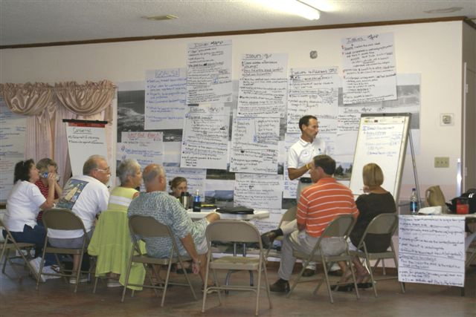
What is research?
Systematic self-critical inquiry made public (Stenhouse, 1981)
Notes:
Not fleeting, sustained by strategy
Research as organized pursuit of curiosity

Slide 6
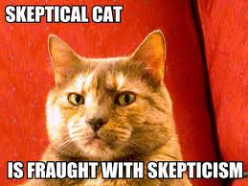
Notes:
Skepticism vs. blind acceptance

Slide 7
You’ve done research. How can you share your research story with prospective employers?

Slide 8
Can you showcase your
skill at locating and applying high
quality information?!
“Getting information off the Internet is like taking a drink from a fire hydrant.”
~Mitchell Kapor

Slide 9
Indy Chamber
Goal: Develop one recommendation to make gains on a target objective.

Slide 10
I interrupted your research task by asking you to complete a research checklist (see the yellow handout!).
Again, please bear in mind that the set of skills that research involves (for example, planning, commitment to a complex task) are the very skills that make you an attractive candidate!!

Slide 11
Many Phases of the Research Process
Notes:
Writing as entering into a conversation

Slide 12
Wisps of Ideas
…where do you
keep them?
Track your inspiration!!

Slide 13
Organize, Organize, Organize
Check out Butler’s LibGuide for tips on reference management and citation guidelines!

