Slide 1
Introduction to Marketing Concepts
Create and Deliver Value
5/26/15

Slide 2
Plan for the Morning
Define Marketing
The Evolution of the Marketing Concept
Marketing Creates Value
Marketing as a Process

Slide 3
What’s Marketing to You?
Marketing is the process of planning and executing the conception, pricing, promotion and distribution of ideas, goods and services to create exchanges that satisfy individual and organizational objectives (AMA).

Slide 4
WHAT IS MARKETING? DELIVERING BENEFITS
Marketing Seeks to:
Discover Needs and Wants of Customers
Satisfy Them
Exchange
AMA Definition of Marketing
1-4

Slide 5
Marketing Exchange
What was exchanged?
Who are the parties involved?

Slide 6
Evolution of the Marketing Concept (Solomon)
Production Era
Management philosophy that emphasizes the most efficient ways to produce & distribute products
Sales Era
Managerial view of marketing as a sales function, or a way to move products out of warehouses to reduce inventory
Relationship Era
A business approach that prioritizes the satisfaction of customers’ needs and wants
Triple Bottom Line
Financial, Social, and Environmental consequences of business decisions

Slide 7
Triple Bottom Line-3Ps (Solomon)
Profit=Financial Bottom Line
Financial profits to stakeholders
People=Social Bottom Line
Contributing to the community
Social marketing
Planet=Environmental Bottom Line
Sustainability
Minimizing footprint
Notes:
Firms embracing this mentality believe that their commitment to quality extends beyond satisfying customer needs during a single transaction.
The triple bottom line orientation focuses on:
building long-term bonds with customers which emphasize financial profits to stakeholders (financial bottom line),
contributing to the communities in which the firm operates (social bottom line), and
creating sustainable business practices that minimize damage to the environment or that even improve it (environmental bottom line).
A second result of the long-term thinking inherent in the triple bottom line era is the social marketing concept, which is defined on the slide. Firms that practice the social marketing concept engage in satisfying environmental concerns, practicing recycling, add extra safety features, or practice sustainability.
Sustainability applies to main aspects of business, including social and economic practices (such as humane working conditions). Another crucial aspect of sustainability examines the environmental impact of the product. Green marketing deals with the development of marketing strategies that support environmental stewardship by creating an environmentally-founded differential benefit in the minds of consumers.
Finally, the last part of the triple bottom line triad requires measuring how much value marketing activities create. This enhanced focus on accountability that typically centers around the calculation off ROI. The accountability aspect means that marketers must do a better job of proving that marketing activities align to the firm’s overall business objectives, especially since many marketing goals have traditionally been phrased in terms of communication aspects (increase awareness). While creating awareness and changing attitudes remains an important part task for marketers, marketing’s efforts must also demonstrate tangible benefits in terms of consumer actions – web site visits, product trial, and of course purchases, to name just a few.

Slide 8
3Ps People, Planet, Profit Marketers
Warby Parker-4 Founding Fathers
Toms-Blake Mycoskie
Laughing Man Coffee-Hugh Jackman
The Honest Company-Jessica Alba

Slide 9
Marketing Utility (Solomon)
Form
Transforming raw materials into finished products
Place
Making products available where consumers want
Time
Storing products until they are needed
Possession
Allowing the consumer to own, use, and enjoy the product
Notes:
UTILITY is defined on the slide as the sum of the benefits we receive from using a product or service.
Marketing can create several different kinds of utility of interest to consumers:
FORM UTILITY: benefit provided by marketing when raw materials are transformed into finished goods; e.g., oats transformed into oatmeal; rubber into tires. (Relates to PRODUCT portion of marketing mix.)
PLACE UTILITY: benefit provided when marketing makes goods available where customers want them; e.g., many things can be purchased over the Internet. (Relates to DISTIBUTION/PLACE portion of marketing mix.)
TIME UTILITY: benefit provided by marketing when products are stored (or inventoried) until they are needed. Stores inventory products, as do wholesalers/distributors, and the manufacturers themselves. (Relates again to DISTRIBUTION/PLACE portion of marketing mix.)
POSSESSION UTILITY: benefit marketing provides by allowing the consumer to own, use, and enjoy the product. Promotional plans that offered deferred payment or even those which feature a sale may be exactly what the consumer needs to own a product. Retail stores and websites offer access to a bewildering array of products.

Slide 10
GOODS
PLACES
SERVICES
EXPERIENCES
EVENTS
WHAT IS MARKETED?
PERSONS
PROPERTIES
INFORMATION
ORGANIZATIONS
IDEAS (Solomon)

Slide 11
Group Discussion Activity
How does marketing affect you?
When you buy books, how do you make those decisions?
When you applied to Butler, how did you market yourself?

Slide 12
The Value Proposition
A way to communicate to customers the benefits that will be realized if a product is purchased or selected
Customer perspective
Costs vs. Benefits
Seller perspective
Develop Brand Ambassadors
Lifetime Value of a Customer
Notes:
Value is in the eye of the beholder because it’s not just about price, and its not just about quality. Value is really a combination of factors, such as price, quality, convenience, delivery/credit, before and after the sale service, etc. Different buyers weight the importance of each element differently, so while some consumers find price more important the before or after the sale service for certain items, other consumers may feel just the opposite.
Marketers need to understand which factors are important to the majority of their customers, so that they can present a strong value proposition (defined on the slide). A major task faced by marketers is convincing consumers that their brand’s value proposition is superior to that of the competition.
Perspectives of value differ between customers, sellers, and society
Value for the seller takes many forms:
Making a profitable exchange
Earning prestige among rivals
Taking pride in doing what a company does well
Nonprofits: motivating, educating, or delighting the public
Customers should be regarded by marketers as partners, rather than as victims. This mentality has led firms to host events, sometimes called brand fests, to thank customers for their loyalty. For example, Triton Boats hosted a fishing contest and invited all bass boat owners to attend free of charge.
It’s important that marketers recognize the value of customers – it is much more costly to replace a customer than it is take the actions necessary to retain them.

Slide 13
Marketing Application
Competitive advantage comes from having distinctive competencies that benefit your clients/customers.
Consider Butler University. What distinctive competencies does it have? What differential benefits does it provide for its students? What is its competitive advantage? What are your suggestions to improve Butler’s competitive position?

Slide 14
Marketing as a Process
Marketing planning is a major portion of the process and involves:
Analyzing the marketing environment
Developing a marketing plan
Deciding on a market segment – segmenting, targeting, and positioning
Choosing the marketing mix—product, price, promotion, and place
Notes:
Marketing is a decision process in which managers determine the strategies that will help the firm meet its long-term objectives, then execute those strategies.
A major portion of the marketing process is marketing planning, in which the big picture and how the firm’s products fit into that picture are considered. First, the marketing environment must be analyzed to determine firm strengths and weaknesses, as well as opportunities or threats stemming from competitors or changes in the legal-political, socio-cultural demographic, technological, or economic environments.
The marketing plan describes the marketing environment, objectives, strategies, and who has responsibility for strategy implementation.
The selection of who should be targeted (target market) with what product or service is critical, as the era of mass marketing (selling to all possible consumers) is vastly inefficient. Instead, firms seek to ID market segments, distinct groups of consumers who are similar in some way but whose needs differ. Positioning is another major strategic decision. A firm’s position is how the target market perceives the product in comparison to competitors brand (discussed in chapter 7.
The promotional mix is also called marketing communications by many scholars, and refers to the unique combination of advertising (including direct response), personal selling, consumer-oriented sales promotion, trade-oriented sales promotion, and brand-oriented publicity and sponsorship efforts that are undertaken on behalf of a particular brand.
The final step of marketing planning involves determination of the marketing mix, discussed in greater detail on the next slide.

Slide 15
A Marketer’s Toolkit: 4Ps (Solomon)

Slide 16
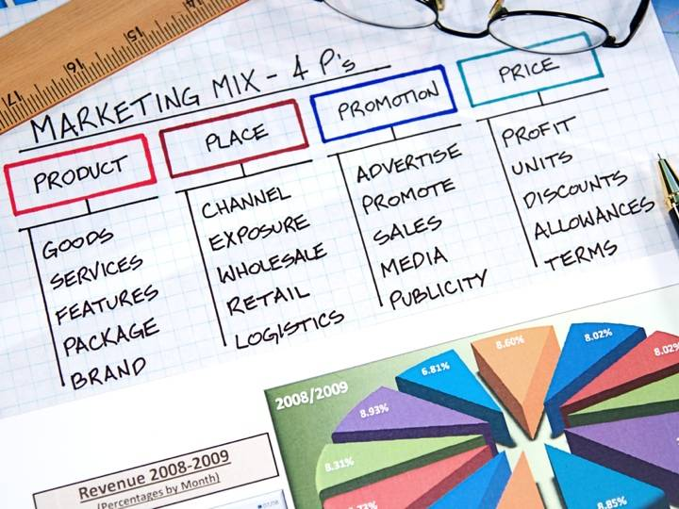
Copyright © 20112Pearson Education, Inc. Publishing as Prentice Hall
Notes:
Marketing Mix involves strategies within four key areas known as the 4P’s
Product, Price, Promotion, Place

Slide 17
Marketer’s Toolkit: Environmental Scan (Solomon)

Slide 18
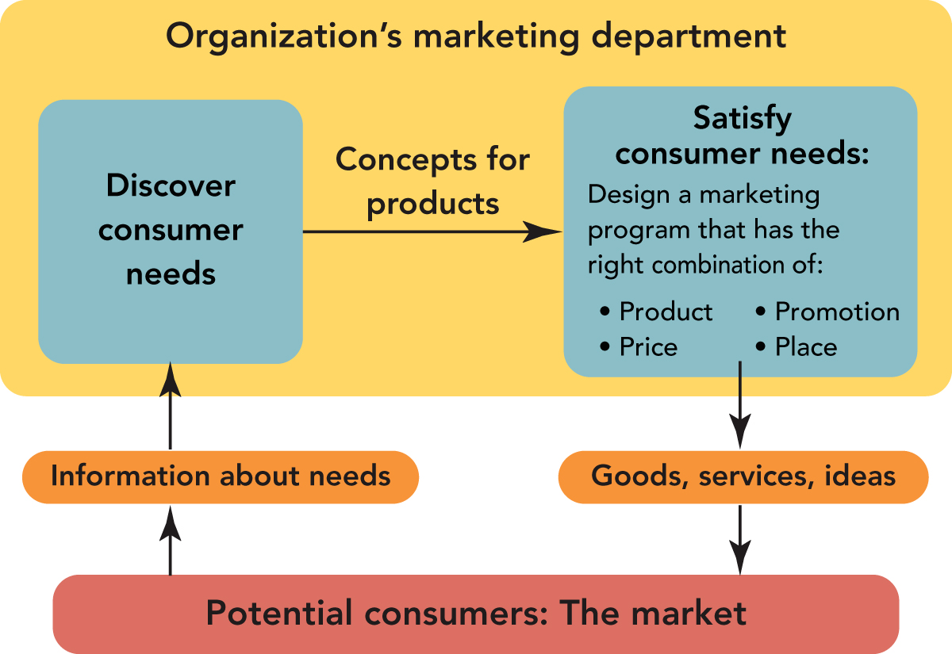
Marketing seeks to discover consumer needs through research and then satisfy them with a marketing program (Kerin).
1-18

Slide 20
The Marketing Process

Slide 21
Three Levels of Planning (Solomon)

Slide 22
Steps in Strategic Planning (Solomon)

Slide 23
(Kerin)
Star Trek Enterprise Why is a mission statement important?
)(Kerub)
2-23

Slide 24
Step 1 Mission Statement
Key questions in determining the mission:
What business are we in?
What customers should we serve?
How do we develop firm’s capabilities and focus its efforts?
Mission statement
A formal document that describes the firm’s overall purpose and what it hopes to achieve in terms of its customers, products, and resources
Notes:
Management’s FIRST step in strategic planning is to create a mission statement (if the firm is new) or review the firm’s mission statement in light of market conditions if a mission statement already exists. IN doing so, upper management seeks to answer the three questions shown on the slide. While mission statements are not meant to change on an annual basis, businesses must be open to changing their mission as consumers needs change and markets evolve.
Based on the answer to the key questions shown, the firm creates or revises the mission statement, or “a formal document that describes the firm’s overall purpose and what it hopes to achieve in terms of its customers, products, and resources.”
Ideally, the mission statement shouldn’t be too broad or too narrow. A mission statement that is too narrow may inhibit managers’ ability to visualize possible growth opportunities. If, for example, a firm sees itself in terms of its product only, consumer trends or technology can make that product obsolete—and the firm is left with no future.

Slide 25
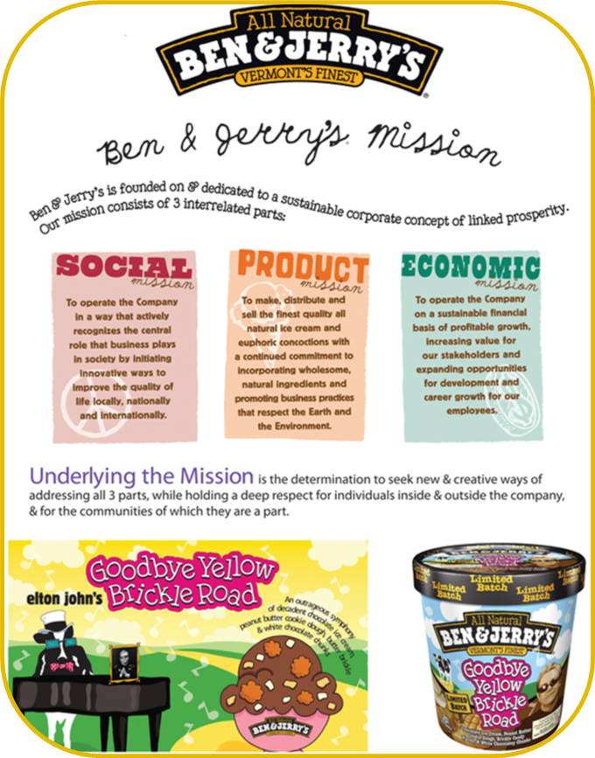
Kerin

Slide 26
Step 2: Situational Analysis (SWOT)
Strengths
Weaknesses
Opportunities
Threats
Notes:
By “internal environment”, we mean all controllable elements within the firm that influence how well it performs. These internal aspects represent key strengths and weaknesses.
External Environment:
Elements outside the firm that may affect it either positively or negatively must be constantly scanned and monitored by businesses on an ongoing basis as part of their strategic planning process. In particular, marketers seek to identify economic, competitive, technological, legal/political/ethical, and sociocultural trends, because these trends manifest as opportunities or threats to the business. Because these factors are external to the firm, marketers cannot directly control them, but they can respond to them via planning.

Slide 27
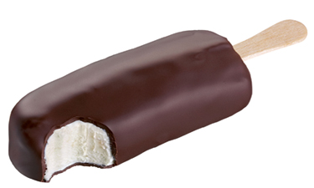
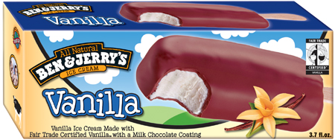
THE STRATEGIC MARKETING PROCESS
THE PLANNING PHASE (Kerin)
Situation Analysis (SWOT)
SWOT Analysis Actions
Build on a Strength (Internal)
Correct a Weakness (Internal)
Exploit an Opportunity (External)
Avoid a Disaster- Laden Threat (External)
2-27

Slide 28
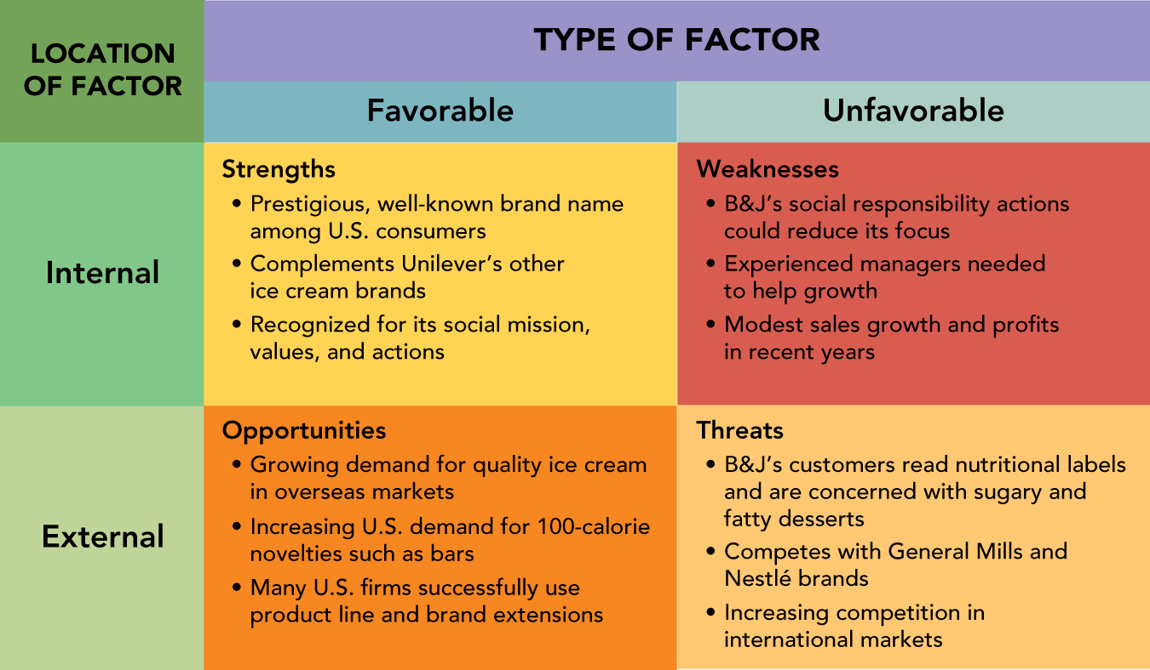
Ben & Jerry’s SWOT Analysis (Kerin)
2-28

Slide 29
Step 3 Objectives
Organizational/SBU Objectives:
What the firm hopes to accomplish with long-range business plan
Need to be SMART-specific, measurable, attainable, relevant, and time-based
May be financially focused, or focused on other factors such as satisfaction
Gain 5% market share in Southwest region in 2016
Develop Twitter campaign to generate new flavors
Notes:
To ensure measurability, marketers increasingly try to state objectives in numerical terms, such as, “Increase corporate profitability by 10%”. Objectives should state WHAT the firm wants to accomplish, but NOT HOW it will be done. The HOW is the strategy. For example, there are many ways to increase profitability (cutting costs, introducing new products, etc.); the correct strategy depends on the internal strengths and weaknesses of the firm and the opportunities that the firm has available to them.

Slide 30
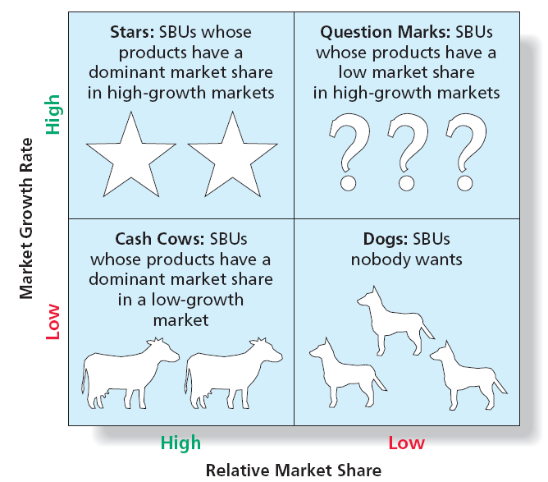
Step 4 Business Portfolio
The group of different products or brands owned by a firm and having different income-generating and growth capabilities (BCG Matrix, Solomon)

Slide 31
Step 5 Growth Strategies (Solomon)
Notes:
Market development – can be where we get the dark side of marketing criticisms from, Smoking and Marlboro Man in China; Also beneficial though in bringing new technologies into markets where they can help
Coca-Cola promotes the use of its product as a rust remover in magazine ads targeting the do-it-yourself auto mechanic (market penetration/new use). This last example can be used to discuss the fact that just because a new use for a product exists, it isn’t always the best strategy to capitalize on it. While soaking rusty items in Coca-Cola will remove their rust, ads promoting this benefit may also cause cola consumers to have second thoughts drinking the product, as it’s a short leap mentally from “rust removal” to “stomach lining removal”.

Slide 32
Ben & Jerry’s Growth Strategies (Kerin)

Slide 33
Steps in Strategic Planning

Slide 34
Three Levels of Planning (Solomon)
Notes:
Step 1: Perform a situation analysis
Builds on SWOT; identifies how environmental trends affect the marketing plan
Step 2: Set marketing objectives
Specific to the firm’s brands and other marketing mix-related elements
States what the marketing function must accomplish if firm is to achieve its overall business objectives

Slide 35
Develop Marketing Strategies (Solomon)
Select target market(s) where the firm’s offerings are best suited
Segmenting-Divide the market
Targeting-Select a demographic
Positioning-Identify competitive points of difference
Develop marketing mix strategies
Product
Price
Promotion
Placement
Notes:
Product strategies include a variety of factors. Certainly a major consideration relates to the nature of the product – its key benefits and attributes. But product strategies also include considerations related to packaging (colors, sizes, materials uses, information included), branding, support services (maintenances, upgrade opportunities, FAQs on websites, etc.), and product variations (flavors, quantities, variations, e.g., Diet vs. Non-Diet).
Pricing Strategies: determine how much a firms charges for a product. As we’ll see later in the semester, setting a price is not an easy task – one must consider cost and competitive factors, the price consumers are willing to pay, and the ability of wholesalers and retailers to markup the product and earn a fair profit. Typically marketers set the price to wholesalers, or if wholesalers are not used, retailers, and suggest a retail price which may or may not be adopted at the point of sale. Sometimes the firm bases its pricing strategy solely on cost, demand, or competitive issues.
A promotional strategy is how marketers communicate a product’s value proposition to the target market. Marketers use promotion strategies to develop the product’s message and the integrated communications mix of advertising, sales promotion, publicity, direct marketing, and personal selling that will deliver the message. As previously discussed, the marketing mix strategy must be devised with the intent of achieving marketing objectives, which in turn, contribute towards the achievement of corporate or SBU objectives.
Distribution strategies outline whether marketers sell the product directly to the final consumer, or if instead they sell to intermediaries, such as wholesalers and retailers, who in turn sell to the ultimate consumer. Not all retailers are equal in terms of their merchandise quality and image; deciding which types of retailers should carry a firm’s products is an important decision. Using the internet as a distribution channel can save a firm money in the case of products or services that can be delivered “virtually”. For example, airlines used to pay travel agents a commission to book flights. The introduction of online travel agents such as Expedia contributed to the demise of over 80% of traditional travel agencies, as online vendors charged a drastically lower commission than did traditional agencies. As of the end of 2010 and beginning of 2011, Southwest Airlines changed their distribution strategy so that flights could only be booked online from their corporate website – essentially choosing to cut out the middleman and sell direct to consumers. In this case, Southwest’s distribution decision impacted their promotional strategy: Southwest advertised heavily on TV and the Internet that the only place to book a Southwest flight was at Southwest.com. While it is still too early to see (as of this writing) whether the strategy succeeds, it demonstrates the power and allure of disintermediation (using technology in this case to cut out the middleman).

Slide 36
Implementation & Control
Control:
Measuring actual performance, comparing performance to the objectives, making adjustments
Marketing metrics:
Return on marketing investment (ROMI)
Action plans:
Support plans that guide the execution and control of marketing strategies at the operational level
Notes:
In practice, marketers spend much of their time managing the various elements involved in implementing the marketing plan. This involves exercising control over the plan in terms of both budget expenditures and performance. Each action plan must include as accurate a budget as is possible. This allows management at the functional level to monitor budget expenditures and contact the appropriate operational manager if a particular budget line is exceeded within some specified time period. In addition to monitoring budget expenditures, managers must select the metrics to be measured as part of the formal control process. Actual performance on key objectives is measured in terms of these metrics (such as Return on Marketing Investment, or ROMI) and comparing it to the numerical objectives previously set.
ROMI is just one example of a marketing metric; others include measures such as new customer acquisition cost, customer retention rate, customer turnover rates, perceived product quality, customer satisfaction etc. See Table 2.3 in the text for additional examples of marketing metrics.
Adjustments are made to plan as needed, if for instance, performance seems to be lagging in comparison to the objective that marketers are trying to reach.
How does the implementation and control step actually manifest itself within a marketing plan? One very convenient way is through the inclusion of a series of action plans that support the various marketing objectives and strategies within the plan. Action plans also help managers when they need to assign responsibilities, create time lines, or develop budgets and measurement and control processes for marketing planning.

Slide 37
Marketing Action Plan
Element of the Marketing Mix | Promotion
Objective | Increase awareness of the service
Action Plan(s) | Advertise on social media sites Buy advertising on Facebook Create a Twitter feed Create a Pinterest page
Responsibility | Promotion creation - Social media intern Promotion approval & funding – Marketing Manager
Time Line | February 1st – Deadline for creating Twitter feed February 3rd – Deadline for creating Pinterest page February 15th – Deadline for buying advertising on Facebook
Budget | $150,000 for Advertising on Facebook
Measurement and Control | Ask customers to complete a brief survey to judge how they heard about the service. Exposure and Click thru rates on Facebook advertising

Slide 38
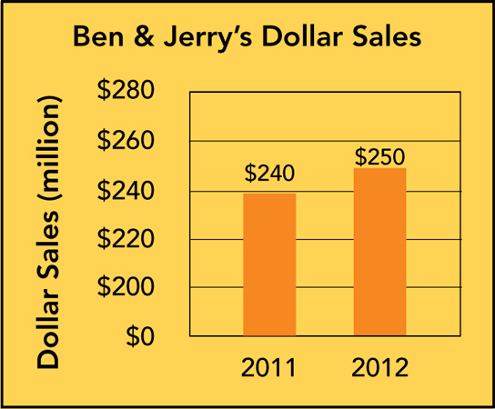
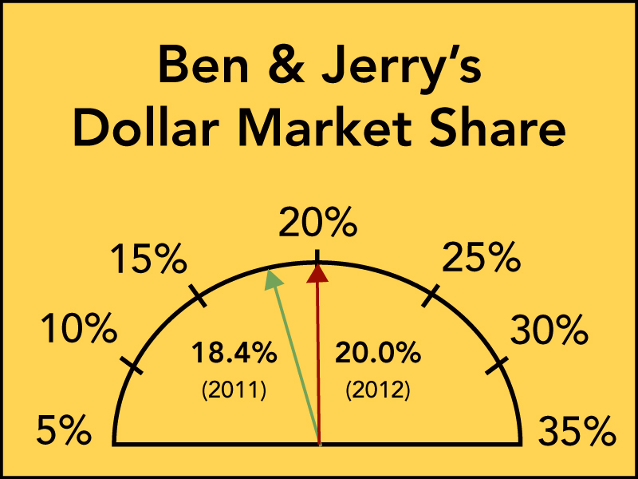
Marketing Metrics How Well is Ben & Jerry’s Doing? (Kerin)
Dollar Sales and Dollar Market Share
2-38

Slide 39
Marketing Application
4 Ps and SWOT
The marketing mix is the set of controllable, tactical marketing tools the firm blends to produce the responses it wants from the target market. These marketing tools can all be collected into four sets of variables known as the “four Ps.” Consider Southwest Airlines. Briefly describe the “four Ps” employed by Southwest.
Construct a SWOT for Southwest and identify market gaps/opportunities.

Slide 40
Day 1 Key Takeaways
Marketing is Everywhere
Marketing is a Process
Everyone Markets the Firm, (not just the marketers)
Marketing is Coordinated Effort, so Planning is Key
Marketing is Gray
Marketing Seeks to Enhance-Sales, Profits, Relationships, Planet

