Slide 1
Summer Fusion 2015
Accounting
The Language of Business
Pamela J. Rouse, C.P.A.
Accounting Instructor, College of Business

Slide 2



What is Accounting???

Slide 3
What is Accounting?
Identifying
Economic
Information
to
various
users
Measuring
Communicating
LO4

Slide 4
The Language of Business
The story of any company, no matter the size, the industry, or the country of origin, is told through its financial records and reports. Income, debt, revenue versus expenses, compensation, and cost of retaining customers can all be found on financial statements.
http://executiveeducation.wharton.upenn.edu/thought-leadership/wharton-at-work/2013/07/language-of-business

Slide 5
The Language of Business
"At some point you move up the hierarchy and you have to provide financial justification and you have to make decisions on numbers that come from other people. If you do not know what you are looking at, and you do not know the right questions to ask..................your effectiveness is diminished.
http://executiveeducation.wharton.upenn.edu/thought-leadership/wharton-at-work/2013/07/language-of-business

Slide 6

The Language of Business
“Accounting is not trendy. Accounting isn't a hot topic. But it's the language of business, and you have to learn it."
Christopher Ittner, Ernst & Young, Wharton Professor of Accounting

Slide 7


Who is the Father of Accounting???

Slide 8
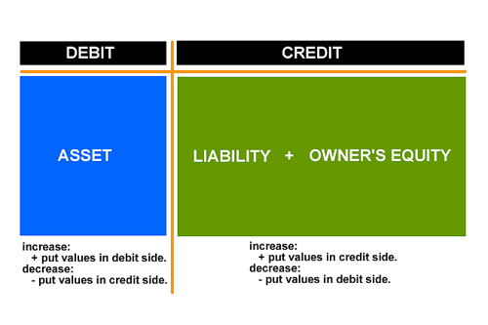
The Father of Accounting
Luca Pacioli
Italian mathematician invented the double entry accounting system in 1494

Slide 9
Who needs Accountants????

Slide 10


















Every Business in Industry, Not for Profit organizations, and Governmental Agencies Need Accountants
Government Agencies
Not for profit Organizations
Manufacturing Industry
Service Industry
Technology Industry
Sports and Entertainment Industry

Slide 11
Accounting Careers
Business Organizations
Public Accounting (CPA Firms)
  Audit
  Tax
  Consulting
Private Accounting (Private Industry)
  Financial
  Managerial/Cost
  Tax
  Financial Planning and Reporting
Non-Business Organization
Governmental Agencies (Federal, State, & Local)
  IRS
  Department of Revenue
  General Accounting Office (GAO)
  Department of Defense
Not for Profit Organizations
  Universities
  Hospitals
  Cooperatives

Slide 12
Purpose of Accounting
Provide useful information to help decision makers make good business decisions relative to economic activity

Slide 13
Users of Accounting Information
    External
Backward Looking
  Balance Sheet
  Income Statement
  Cash Flow Statement
  Notes in the Annual Report
  Bound by GAAP (Generally Accepted Accounting Principles)
Internal
Forward Looking
  Whatever information is needed to help internal managers make good economic decisions for the organization
  Not Bound by GAAP

Slide 14
Internal and External
Users of Accounting Information
Bankers
Creditors
Current
and
Potential
Owners
Internal
Users –
Management
Financial
Analysts
Suppliers
Trade
Associations
Government
Agencies
Notes:
12
12

Slide 15
Accounting Jeopardy
(Round 1)
“The Accounting
Profession”

Slide 16
Generally Accepted
Accounting Principles
The various methods, rules, practices and other procedures that have evolved over time that regulate the preparation of financial statements
Notes:
25
25

Slide 17
The Rules of the Game
The rules
The rule makers
The rule enforcers
The CPA regulators
1933 and 1934 SEC ACT
GAAP
FASB
SEC
AICPA
LO7
Notes:
26
26

Slide 18
International
Accounting Standards
International Accounting Standards Board was created in 2001
There may be significant differences between U.S. and international standards

Slide 19
Auditing
Financial statements are prepared by and are the responsibility of the company’s management
External auditors perform tests and procedures to render an opinion the financial statements are fairly presented

Slide 20
Ethics in Accounting
Ethics plays a critical role in providing useful financial information
Investors and other users must have confidence in a company, its accountants, and its outside auditors that the information presented in financial statements is relevant, complete, neutral, and free from error
LO 8

Slide 21
The Changing Face of the Accounting Profession
A “financial reporting crisis” caused by:
Enron: the omission of entities from the
financial statements
WorldCom: treating costs as assets rather than expenses causing higher net income

Slide 22
Sarbanes-Oxley Act
Provisions of the act:
Established the Public Company Accounting Oversight Board
Required external auditors to report directly to the company’s audit committee
Prohibits external auditors from providing other services compromising independence

Slide 23
Accounting Jeopardy
(Round 2)
“The Accounting
Rule Makers”

Slide 24
What is Business
to provide members of an economic system
with goods and services
Activities
LO1

Slide 25
Forms of Business Organizations
Sole Proprietorship
one owner
Partnership
two or more owners
entity organized under laws of a particular state
Corporation
LO2

Slide 26
Non-business Entities
Government entities
Private Organizations
Federal, State and
Local Governments
Hospitals, Universities,
Cooperatives

Slide 27
The Nature of Business Activity
(Transformation Process)
Financing
Activities
Investing
Activities
Operating
Activities
Examples:
borrowing
sale of stock
Examples:
Examples:
borrowing
sale of stock business
purchase of assets
LO3

Slide 28
The Accounting Equation
Assets = Liabilities + Owners’ Equity
(or Stockholders’ Equity)
Economic
resources
Creditors’
claims
to assets
Owners’
claims
to assets
=
+
Examples:
Cash
Accounts receivable
Land
Accounts payable
Notes payable
Capital stock
Retained earnings
LO5
Notes:
14
14

Slide 29
Jeopardy
(Round 3)
“Transformation and Organizations”

Slide 30

Financial Statements
Balance Sheet
Income Statement
Cash Flows Statement

Slide 31
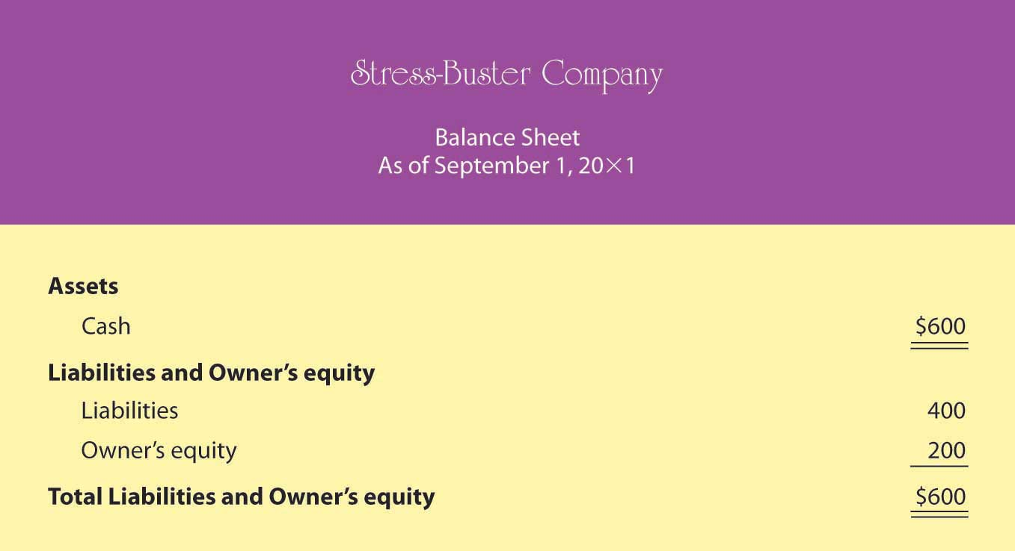
Balance Sheet
Assets
(Resources owned by the organization
that will be used to provide future
Economic benefit)
=
Liabilities
(Amounts owed to creditors)
+
Owners’ Equity
(or Stockholders’ Equity)
(The residual claim on the company’s assets,
i.e. the owner’s interest/claim)
Notes:
15
15

Slide 32
Balance Sheet
(snapshot of financial position)
Assets
Liabilities
=
+
Owners’ Equity
(or Stockholders’ Equity)
Notes:
15
15

Slide 33

Balance Sheet
(Statement of Financial Position)
Why is this important?
The
The Balance Sheet shows how the assets were financed. It shows the claim on assets by creditors (debt) and the claim on assets by the owners (owners’ interest).

Slide 34
The Balance Sheet Measures Net Worth.
What is Net Worth???

Slide 35

Net Worth
.
Assets - Liabilities = Stockholders’ Equity
or
                Net Worth
                Net Worth is the amount by which assets exceed liabilities

Slide 36
The World’s Billionaires are measured by Net Worth
Who do you think is the world’s richest billionaire???

Slide 37

What is Bill Gates’ Net Worth?

Slide 38
World’s Richest Billionaires
# 1 Bill Gates (Microsoft) $ 80 B
# 3 Warren Buffet (Berkshire Hathaway) $ 73 B
# 5 Larry Ellison (Oracle) $ 54 B
# 8 Christy Walton (Walmart) $ 42 B
# 9 Jim Walton (Walmart) $ 41 B
# 15 Jeff Bezos (Amazon) $ 35 B
# 16 Mark Ziclerberg (Facebook) $ 33 B
# 20 Sergey Brin (Google) $ 29 B
# 45 Lauren Powell Jobs (Apple,Disney) $ 20 B
# 47 Michael Dell (Dell) $19 B

Slide 39
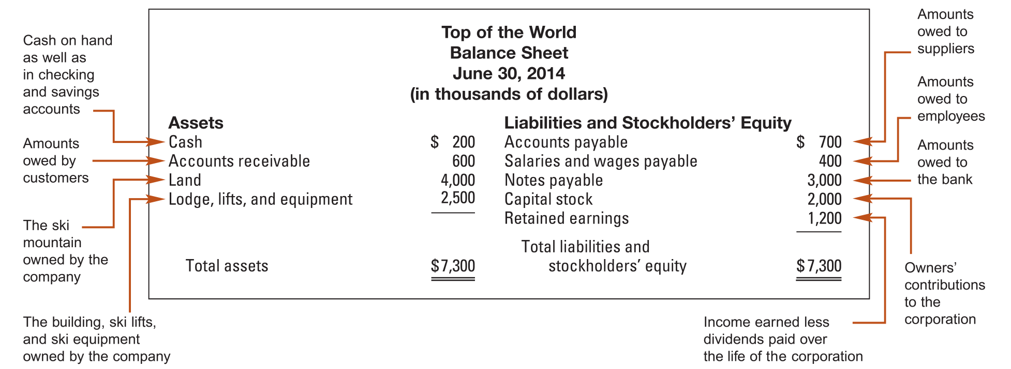
Sample Balance Sheet

Slide 40
Balance Sheet Analysis
Return on Equity (ROE) Ratio
ROE = Net Income = $ 600 = 18.75%
      Stockholders’ Equity $ 3,200

Slide 41
Income Statement
(for a period of time)
Revenues $$
Less: Expenses ($$)
Net income $$
Measures operating results for goods and services sold during the period less the expenses related to the revenue recognized during the period.
Notes:
16
16

Slide 42
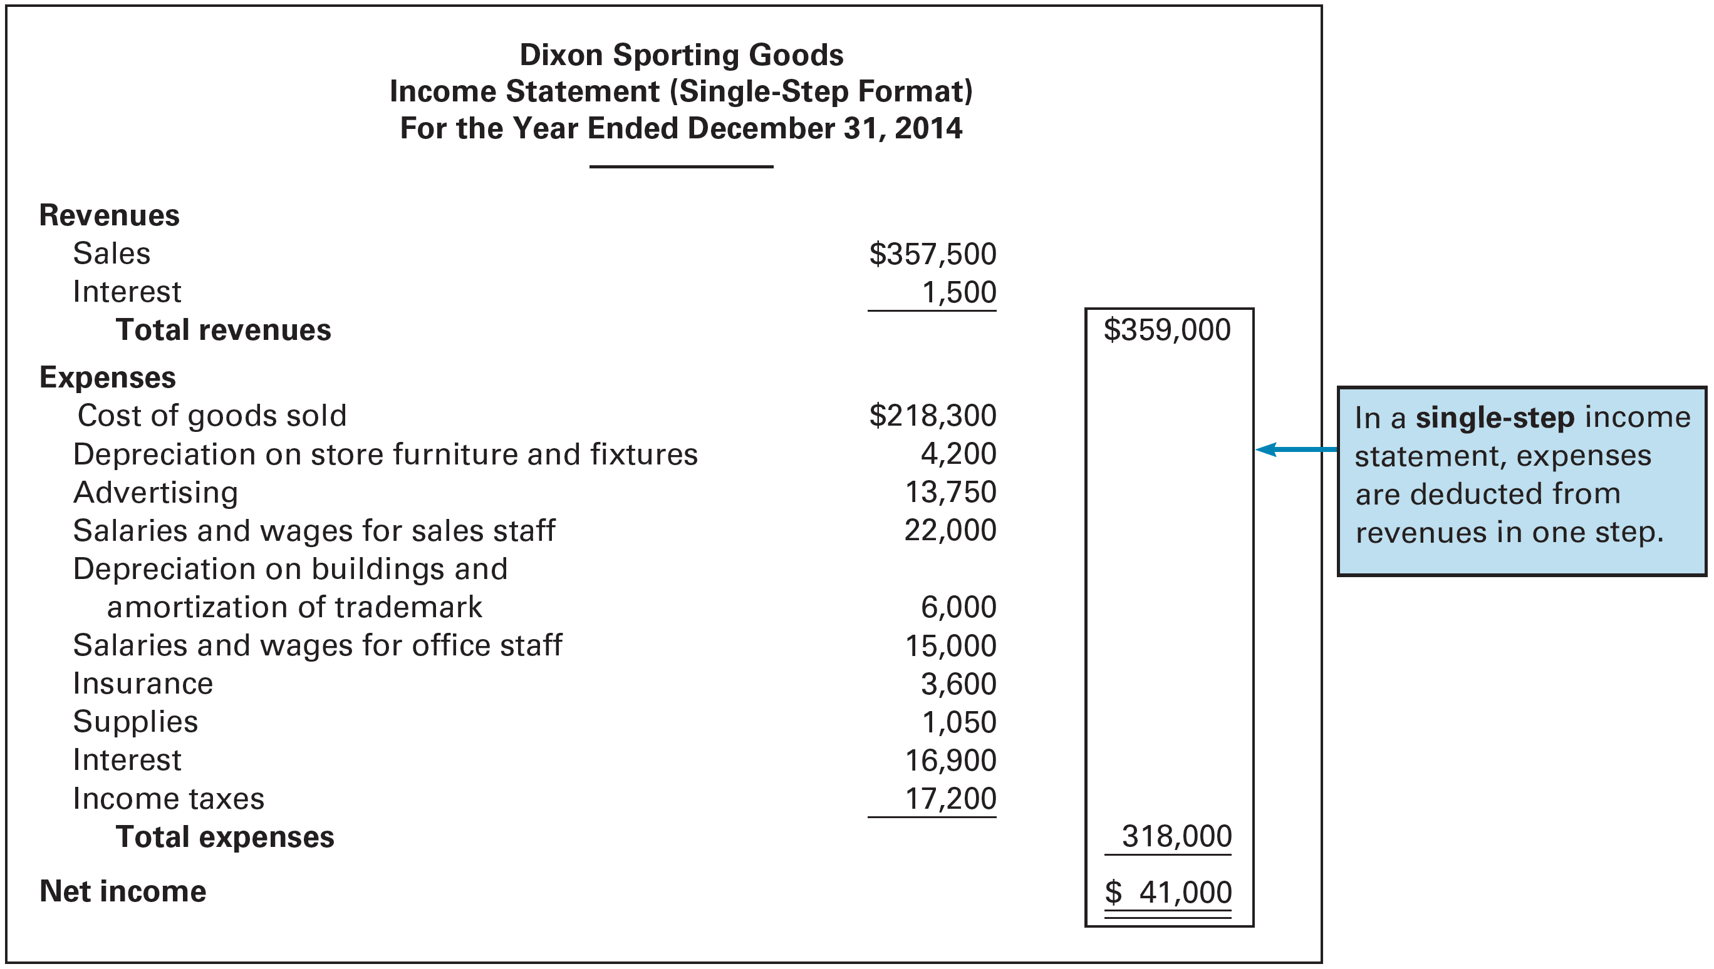
Sample Income Statement

Slide 43
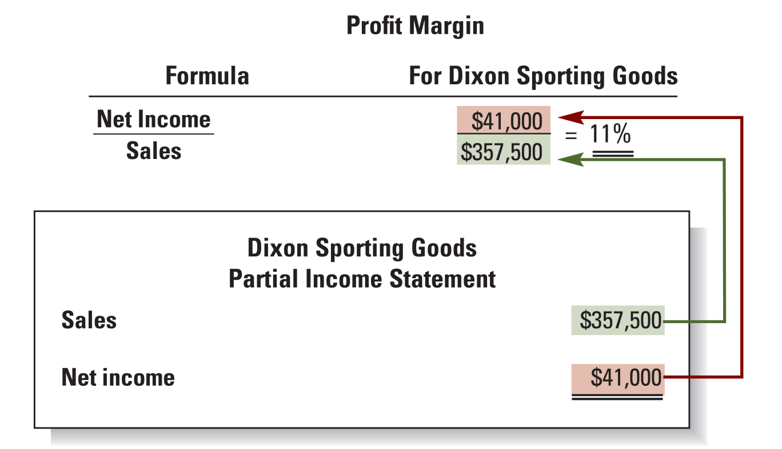
Income Statement Analysis
Return on Sales (ROS) Ratio

Slide 44
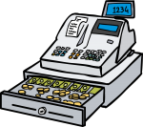
The Statement of Cash Flows
Summarizes a company’s cash receipts and cash payments during the period from operating, investing, and financing activities
Each of these categories can result in a net inflow or a net outflow of cash

Slide 45
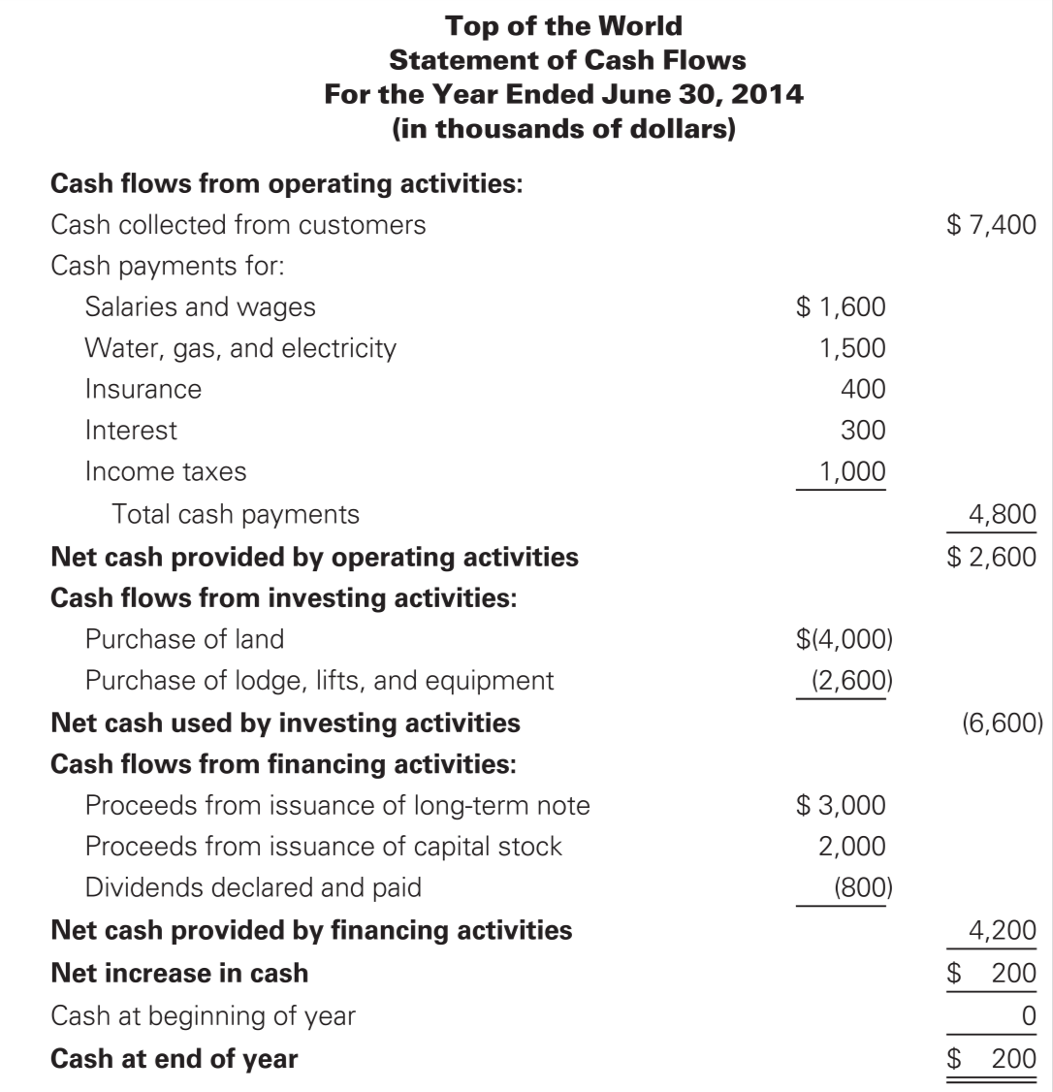
Sample Statement of Cash Flows

Slide 46
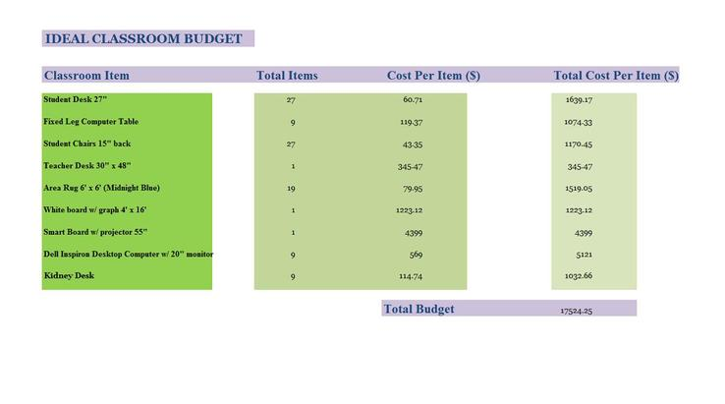
Budgeting (Internal Reporting)
A budget is a detailed quantitative plan for acquiring and using financial and other resources over a specified forthcoming time period.

Slide 47
The Master Budget: An Overview
Sales budget
Selling and
administrative
budget
Ending inventory
budget
Production budget
Direct materials
budget
Direct labor
budget
Manufacturing
overhead budget
Cash Budget
Budgeted
income
statement
Budgeted
balance sheet

Slide 48
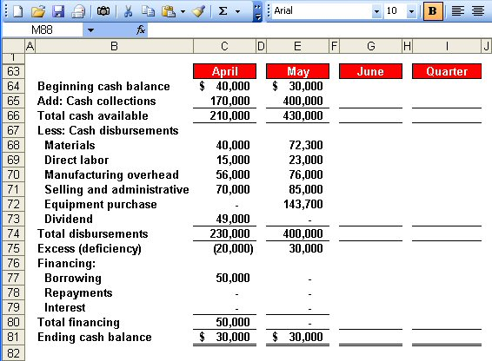
The Cash Budget

Slide 49
Accounting Jeopardy
(Round 4)
“Financial Statements and Reporting”

Slide 50
Accounting Jeopardy
(Round 5)
“Financial Statements and Reporting”

Slide 51
Accounting Jeopardy
(Final Jeopardy)
“Financial Statements”

Slide 52
Final Jeopardy Question
What is Net Worth???

