Slide 1
Economic Opportunity
Summer Fusion 2015

Slide 3
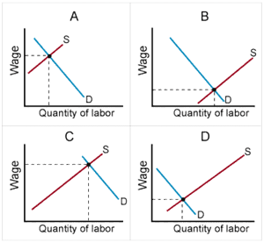
The Space
Labor markets:
demand for workers
supply of people who can and will work

Slide 4
The (Labor Market) Space
Industries
Industry clusters

Slide 5
Indianapolis’ Industry Clusters
www.indychamber.com/economic-development/why-indy-region
Indy Chamber

Slide 6
Cluster Mapping
www.clustermapping.us
U.S. Cluster Mapping Project
(Harvard School of Business + EDA)

Slide 7
www.iseek.org
Career Clusters
Career Pathways

Slide 8
Occupations
www.hoosierdata.in.gov

Slide 9
Connecting in Indy
Plan 2020
www.plan2o2o.com
Local Initiatives Support Corporation www.liscindianapolis.org

Slide 10
Think big.

Slide 11
Butler Advance
Let’s make connections.

Slide 12
You
Be yourself.
“To be yourself in a world that is constantly trying to make you something else is the greatest accomplishment.”
Ralph Waldo Emerson

Slide 14
Happy

