Slide 1
The Entrepreneurial Process
Process:
Developing opportunities
Gathering resources
Managing and building operations
Goal:
Creating value
“Can’t extract value until you create value”

Slide 2
Entrepreneurship Fundamentals
Entrepreneurship:
process of changing ideas into commercial opportunities and creating value
Entrepreneur:
individual who thinks, reasons, and acts to convert ideas into commercial opportunities and to create value

Slide 3
Entrepreneurial Traits or Characteristics
A successful entrepreneur:
Sees and seizes a commercial opportunity
Tends to be doggedly optimistic (perhaps even to a fault)
Plans to obtain the physical, financial, and human resources needed for the venture to succeed

Slide 4
Opportunities Exist but Not Without Risks
Risks:
Annual employer firm births (~659,093 in 2005-07) slightly exceeds terminations (~578,793 in 2005-07)
Note, however, that bankruptcies are only a fraction (~29,073) of terminations - terminations not all “bad”
For new firms, a representative study (Headd) found
(a) one-third of new employer firms endure < 2 years
(b) one-half endure < 4 years
(c) 60 percent endure < 6 years
(d) but, about one-third were “successful” at closing

Slide 5
Sources of Entrepreneurial Opportunities
Research (J. Case) suggests
12% of Inc. 500 success is due to extraordinary idea
88% due to exceptional execution of ordinary idea

Slide 6
Demographic Changes
Harry Dent’s Generations – The Baby Boom
1. Spending wave (1990’s)
- Behind the stock and bond market booms
2. Power wave (to peak in the 2020’s)
- Aging baby boomers with great business influence
- Aging baby boomers provide business opportunities – creating them, financing them, using them

Slide 7
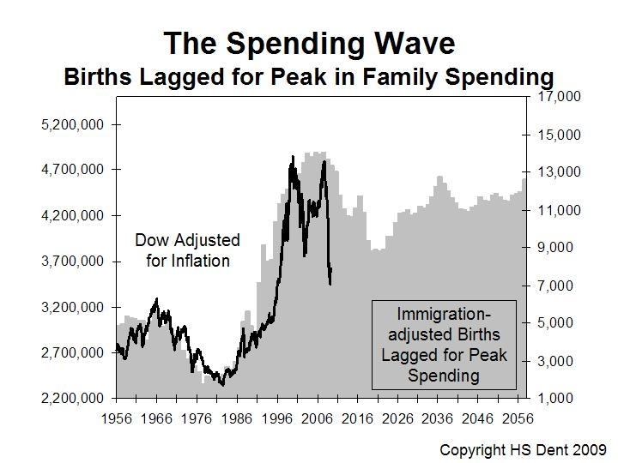

Slide 8
E-Finance Principle #1
Real, Human, and Financial Capital Must be Rented from Owners
Money has owners and therefore costs
Time value
Risk
Expect to provide a return or the venture will not survive in a market economy

Slide 9
E-Finance Principle #2
Risk and Expected Reward Go Hand in Hand
Time value is not the only cost when using others’ funds
More risk => More expected reward
How much more? Market-determined!

Slide 10
E-Finance Principle #3
While Accounting is the Language of Business, Cash is the Currency
Two important reasons to employ accounting:
Tracking and accountability for actions taken
Quantifying different visions of the future
But, remember cash flow is a new venture’s lifeblood
“Get enough accounting to see through the accruals to the cash account”
Cash burn: gap between cash being spent and that being collected
Cash build: excess of cash receipts over cash distributions

Slide 11
E-Finance Principle #4
New Venture Financing Involves Search, Negotiation, and Privacy
Public Financial Markets: standard contracts traded on organized exchanges
Private Financial Markets: customized contracts bought and infrequently sold in inefficient private negotiations

Slide 12
E-Finance Principle #5
A Venture’s Financial Objective is to Increase Value
Many objectives, including personal ones
But, the unifying financial objective is to increase value
rather than price, margin or sales
rather than profit, return or net worth
(Market) Value derives from the ability to generate cash to pay capital providers for their capital

Slide 13
E-Finance Principle #6
It is Dangerous to Assume that People Act Against Their Own Self-Interest
Aligning incentives (investors, founders, employees, spouses, etc.) is critical
As situations change, incentives diverge and renegotiation is important
Owner-manager conflicts: differences between a manager’s self-interest and that of the owners who hired him/her
Owner-debtholder agency conflict: divergence of the owners’ and lenders’ self-interests

Slide 14
E-Finance Principle #7
Venture Character and Reputation Can be Assets or Liabilities
Ventures have character that can be different from the individuals who founded or manage it
Many entrepreneurs state that high ethical standards are one of a venture’s most important assets and are critical to long-term success and value
Ventures can - and do - make meaningful societal contributions
Many successful entrepreneurs are financially and personally involved in charitable endeavors

Slide 15
Role of Entrepreneurial Finance
Entrepreneurial Finance
application and adaptation of financial tools and techniques to the planning, funding, operation, and valuation of an entrepreneurial venture

Slide 16
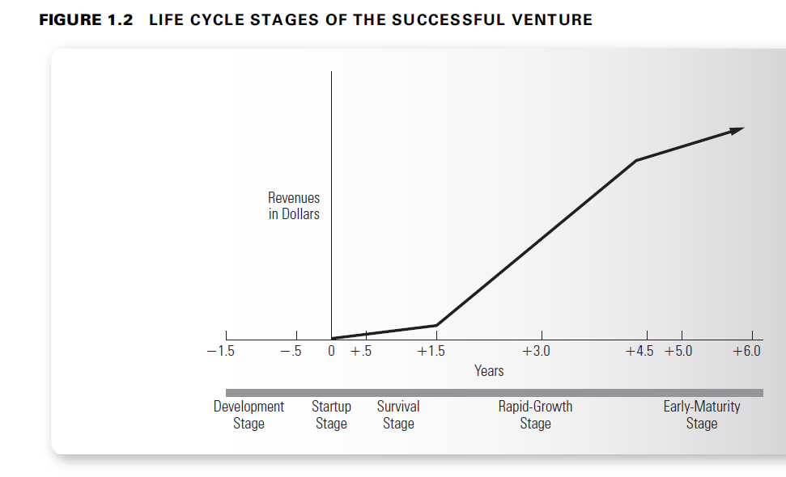

Slide 17
Financing Through the Successful Venture Life Cycle
Development Stage
Developing opportunities and seed financing
Startup Stage
Gathering resources and startup financing
Survival Stage
Gathering resources, managing and building operations and first-round financing
Rapid-Growth Stage
Managing and building operations and second-round mezzanine, & liquidity stage financing
Early Maturity Stage
Managing and building operations and obtaining bank loans, issuing bonds, & issuing stock

Slide 18
Selected Financing Definitions
Seed Financing:
funds needed to determine whether the idea can be converted into a viable business opportunity
Startup Financing:
funds needed to take the venture from having established a viable business opportunity to initial production and sales

Slide 19
Selected Financing Definitions
Venture Capital:
early-stage financial capital often involving substantial risk of total loss
Venture Capitalists:
individuals who join in formal, organized firms to raise and distribute venture capital to new and fast-growing ventures
Business Angels:
wealthy individuals operating as informal or private investors who provide venture financing for small businesses
Investment Banker:
individual working for an investment bank who advises and assists corporations in their security financing decisions and regarding mergers and acquisitions

Slide 20
