Slide 1
Summer Fusion 2015
Prof Jim McKneight
Financial Management: Accounting, Finance, Break Even, 5 C’s of Credit
McGraw-Hill/Irwin
Copyright © 2013 by The McGraw-Hill Companies, Inc. All rights reserved.

Slide 2
Opening Questions
Are Finance & Accounting the same thing?
If not, what’s the difference?

Slide 3
The Role of Accounting
Accounting reports and financial statements reveal as much about a business’s health as pulse and blood pressure readings tell us about a person’s health.
Thus, you have to know something about accounting if you want to succeed in business.
It is almost impossible to understand business operations without being able to read and analyze accounting reports and financial statements.

Slide 4
The Accounting System

Slide 5
The Accounting Cycle
Accounting Cycle -- A six-step procedure that results in the preparation and analysis of the major financial statements.

Slide 6
Statement of Cash Flows: Definition and Use
Statement of Cash Flows:
shows how cash, reflected in accrual accounting, flowed into and out of a firm during a specific period of operation
Can be used to determine if a venture has been building or burning cash
“Net Cash Burn” occurs when the sum of cash flows from “operations” and “investing” is negative

Slide 8
Financial Statement Analysis
Outside users are interested in these questions:
Is the organization profitable?
Is it able to pay its bills?
How much debt does it owe?
To answer these questions, financial ratios are often used.

Slide 9
COMMONLY USED RATIOS
Liquidity ratios measure a firm’s ability to turn assets into cash to pay its short-term debts.
Key ratio: Current Ratio (Current Assets / Current Liabilities)
This information is found on the firm’s balance sheet.
17-9
Notes:
The acid-test ratio is sometimes referred to as the quick ratio.

Slide 10
COMMONLY USED RATIOS
Leverage ratios measure the degree to which a firm relies on borrowed funds in its operations.
Key ratio: Debt to Owner’s Equity Ratio (Total Debt / Total Owners Equity)
This information is found on the firm’s balance sheet.
17-10

Slide 11
Financial Break Even
One of the most important financial concepts is the concept of financial break even.
Why? Because you do not make a single dollar of profit until you first break even.
Most businesses fail to reach their profit potential because the owners have not performed B/E analysis.
Managing your fixed costs and using B/E analysis to make spending decisions will save you thousands of dollars!
This break even concept works for personal finances too, it is essentially an easy way to budget.

Slide 12
Breakeven Analysis: Basic Terms
Variable Expenses:
costs or expenses that vary directly with revenues
Fixed Expenses:
costs that are expected to remain constant over a range of revenues for a specific time period
Basic Equations:
Breakeven Point (units) = Fixed Costs / Contribution Margin Per Unit
Breakeven Point (revenue) = BE Point (units) x Price per unit
(Handout Problems)

Slide 13
WHAT’S FINANCE?
The Role of Finance and Financial Managers
LG1
Finance -- The function in a business that acquires funds for a firm and manages them within the firm.
Finance activities include:
Preparing budgets
Creating cash flow analyses
Planning for expenditures
18-13
Notes:
See Learning Goal 1: Explain the responsibilities of financial managers.
The finance function is responsible for managing a scarce resource - capital.

Slide 14
FINANCIAL MANAGEMENT
The Role of Finance and Financial Managers
LG1
Financial Management -- The job of managing a firm’s resources to meet its goals and objectives.
18-14
Notes:
See Learning Goal 1: Explain the responsibilities of financial managers.

Slide 15
FINANCIAL MANAGERS
The Role of Finance and Financial Managers
LG1
Financial Managers -- Examine financial data and recommend strategies for improving financial performance.
Financial managers are responsible for:
Paying company bills
Collecting payments
Staying abreast of market changes
Assuring accounting accuracy
18-15
Notes:
See Learning Goal 1: Explain the responsibilities of financial managers.
This slide provides insight into the role of financial management.
One point that is critical to communicate to students, is that financial managers must understand accounting (and in fact many of them have backgrounds in accounting), but they are not accountants within the company. They are decision-makers and managers in the truest sense of the word.
You might want to work through each of the functions of the financial manager and make certain students see exactly what’s involved in such a job. Students often perk up when they hear that quite often next to the company CEO, the chief financial officer (CFO) is the highest paid person within an organization. It’s also a good time with this slide to reinforce exactly how the relationship between accounting and finance works. If students can catch on early, this chapter is easy for them to navigate.

Slide 16
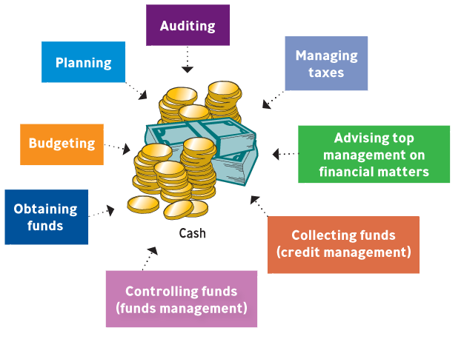
WHAT FINANCIAL MANAGERS DO
The Role of Finance and Financial Managers
LG1
18-16
Notes:
See Learning Goal 1: Explain the responsibilities of financial managers.
This slide (based on Figure 18.1) gives the student a broad overview of what responsibilities financial managers have within a corporation. The CFOs responsibilities are rooted in the functions of “control” and “treasury.”
The control function has its basis in the budgeting process:
The budget represents the quantification of the goals and missions of the company as manifested by the resources required to attain those goals.
The budget becomes the scorecard by which the company as a whole is measured.
3. The other area of responsibility for CFOs is the treasury function.
Procurement of financial resources available to the company.
Ongoing communication with financial sources, investors, and debt holders who must be kept apprised of the firm’s financial performance.
Allocation of resources within the context of the company budget.

Slide 17
WHY DO FIRMS FAIL FINANCIALLY?
The Value of Understanding Finance
LG1
Undercapitalization
Poor control over cash flow
Inadequate expense control
18-17
Notes:
See Learning Goal 1: Explain the responsibilities of financial managers.

Slide 18
TOP FINANCIAL CONCERNS of COMPANY CFOs - MICRO
The Value of Understanding Finance
LG1
Ability to maintain margins
Ability to forecast results
Maintaining morale/productivity
Cost of healthcare
Working-capital management
Source: CFO Magazine, July/August 2010.
18-18
Notes:
See Learning Goal 1: Explain the responsibilities of financial managers.
Top Financial Concerns of Company CFOs - Micro
This slide highlights the top concerns of company CFOs within their own businesses.
The Chief Financial Officers of companies must concern themselves with a multitude of issues.

Slide 19
FINANCIAL PLANNING
Financial Planning
LG2
Financial planning involves analyzing short-term and long-term money flows to and from the company.
Three key steps of financial planning:
Forecasting the firm’s short-term and long-term financial needs.
Developing budgets to meet those needs.
Establishing financial controls to see if the company is achieving its goals.
18-19
Notes:
See Learning Goal 2: Outline the financial planning process and explain the three key budgets in the financial plan.

Slide 20
FINANCIAL FORECASTING
Forecasting Financial Needs
LG2
Short-Term Forecast -- Predicts revenues, costs and expenses for a period of one year or less.
Cash-Flow Forecast -- Predicts the cash inflows and outflows in future periods, usually months or quarters.
Long-Term Forecast -- Predicts revenues, costs, and expenses for a period longer than one year and sometimes as long as five or ten years.
18-20
Notes:
See Learning Goal 2: Outline the financial planning process and explain the three key budgets in the financial plan.

Slide 21
BUDGETING
Working with the Budget Process
LG2
Budget -- Sets forth management’s expectations for revenues and allocates the use of specific resources throughout the firm.
Budgets depend heavily on the balance sheet, income statement, statement of cash flows and short-term and long-term financial forecasts.
The budget is the guide for financial operations and expected financial needs.
18-21
Notes:
See Learning Goal 2: Outline the financial planning process and explain the three key budgets in the financial plan.
Budgeting is critical for the organization to control expenses and to understand revenue expectations.
Think of a budget as a guidepost or a reference point for the organization’s managers.

Slide 22
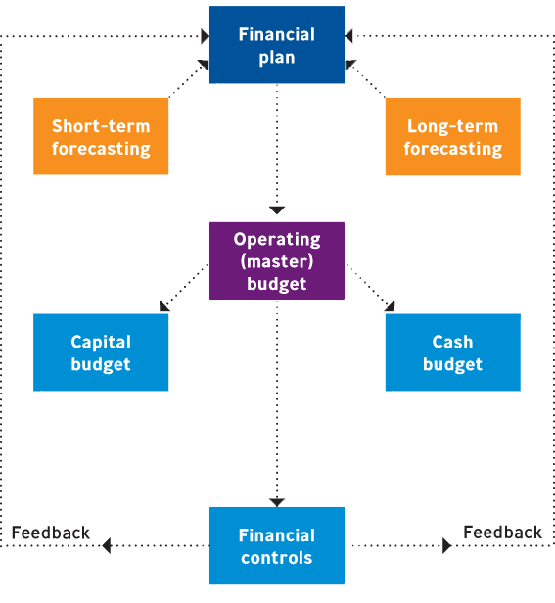
FINANCIAL PLANNING
Working with the Budget Process
LG2
18-22
Notes:
See Learning Goal 2: Outline the financial planning process and explain the three key budgets in the financial plan.
This slide is based on Figure 18.2.
The capital and cash budgets are part of the operating (master) budget.

Slide 23
KEY NEEDS for OPERATIONAL FUNDS in a FIRM
The Need for Operating Funds
LG3
Managing day-by-day needs of the business
Controlling credit operations
Acquiring needed inventory
Making capital expenditures
18-23
Notes:
See Learning Goal 3: Explain why firms need operating funds.

Slide 24
HOW SMALL BUSINESSES CAN IMPROVE CASH FLOW
The Need for Operating Funds
LG3
Be more aggressive in collecting accounts receivable.
Offer customers discounts for paying early.
Take advantage of special payment terms from vendors.
Raise prices.
Use credit cards discriminately.
Source: American Express Small Business Monitor.
18-24
Notes:
See Learning Goal 3: Explain why firms need operating funds.
How Small Businesses Can Improve Cash Flow
The slide lists methods small businesses use to improve cash flow.
Lack of cash flow can impact a business of any size and may lead to the business shutting its doors.
It is critical that students understand cash is king for a business of any size.

Slide 25
USING ALTERNATIVE SOURCES of FUNDS
Alternative Sources of Funds
LG3
Debt Financing -- The funds raised through various forms of borrowing that must be repaid.
Equity Financing -- The funds raised from within the firm from operations or through the sale of ownership in the firm (such as stock).
18-25
Notes:
See Learning Goal 3: Explain why firms need operating funds.

Slide 26
SHORT and LONG-TERM FINANCING
Alternative Sources of Funds
LG3
Short-Term Financing -- Funds needed for a year or less.
Long-Term Financing -- Funds needed for more than a year.
18-26
Notes:
See Learning Goal 3: Explain why firms need operating funds.

Slide 27
WHY FIRMS NEED FINANCING
Alternative Sources of Funds
LG3
Short-Term Funds | Long-Term Funds
Monthly expenses | New-product development
Unanticipated emergencies | Replacement of capital equipment
Cash flow problems | Mergers or acquisitions
Expansion of current inventory | Expansion into new markets
Temporary promotional programs | New facilities
18-27
Notes:
See Learning Goal 3: Explain why firms need operating funds.
This slide is based on Figure 18.5.
It is important for management to understand that they need capital for a variety of short-term and long-term situations.

Slide 28
TYPES of SHORT-TERM FINANCING
Trade Credit
LG4
Trade Credit -- The practice of buying goods or services now and paying for them later.
Businesses often get terms 2/10 net 30 when receiving trade credit.
Promissory Note -- A written contract agreeing to pay a supplier a specific sum of money at a definite time.
18-28
Notes:
See Learning Goal 4: Identify and describe different sources of short-term financing.
Trade credit is the most common form of financing. 2/10 net 30 means a firm can receive a 2% discount if the bill is paid within 10 days. If they choose not to take the discount, the net amount is due in 30 days.

Slide 29
DIFFICULTY of OBTAINING SHORT-TERM FINANCING
Commercial Banks
LG4
Banks generally prefer to lend short-term money to larger, more established businesses.
The recent financial crisis has made it difficult for even promising and well-organized businesses to get loans.
18-29
Notes:
See Learning Goal 4: Identify and describe different sources of short-term financing.

Slide 30
DIFFERENT FORMS of SHORT-TERM LOANS
Different Forms of Short-Term Loans
LG4
Commercial banks offer short-term loans like:
Secured Loans -- Backed by collateral.
Unsecured Loans -- Don’t require collateral from the borrower.
Line of Credit -- A given amount of money the bank will provide so long as the funds are available.
Revolving Credit Agreement -- A line of credit that’s guaranteed but comes with a fee.
18-30
Notes:
See Learning Goal 4: Identify and describe different sources of short-term financing.

Slide 31
CREDIT CARDS
Credit Cards
LG4
Rates for small businesses grew almost 30% after the Credit Card Responsibility Accountability and Disclosure Act was passed.
Credit cards are convenient but costly for a small business.
Photo Courtesy of: Robert Scoble
18-31
Notes:
See Learning Goal 4: Identify and describe different sources of short-term financing.

Slide 32
WAYS to RAISE START-UP CAPITAL
Credit Cards
LG4
Seek out a microloan from a microlender
Use asset-based lending or factoring
Turn to the web and seek out peer-to-peer lending
Research local banks
Sweet-talk vendors you want to do business with
Source: Entrepreneur, www.entrepreneur.com, accessed July 2011.
18-32
Notes:
See Learning Goal 4: Identify and describe different sources of short-term financing.
Ways to Raise Start-Up Capital
This slide profiles some of the unique methods businesses can use to raise capital.
Trade credit and factoring are two of the oldest methods of raising capital. To start a discussion with students ask the advantages and disadvantages of using each of these methods.
Peer-to-peer lending involves individuals loaning money to other individuals or businesses thus bypassing traditional lending outlets.
For more information on this new method use loan statistics from www.lendingclub.com

Slide 33
USING LONG-TERM DEBT FINANCING
Debt Financing
LG5
Long-term financing loans generally come due within 3 -7 years but may extend to 15 or 20 years.
Term-Loan Agreement -- A promissory note that requires the borrower to repay the loan with interest in specified monthly or annual installments.
A major advantage of debt financing is the interest the firm pays is tax deductible.
18-33
Notes:
See Learning Goal 5: Identify and describe different sources of long-term financing.
Lenders may also require certain restrictions to force the firm to act responsibly.

Slide 34
SECURING EQUITY FINANCING
Equity Financing
LG5
A company can secure equity financing by:
Selling shares of stock in the company.
Earning profits and using the retained earnings as reinvestments in the firm.
Attracting Venture Capital -- Money that is invested in new or emerging companies that some investors believe have great profit potential.
18-34
Notes:
See Learning Goal 5: Identify and describe different sources of long-term financing.

Slide 35
The FIVE “C”s of CREDIT
Obtaining Long-Term Financing
LG5
The character of the borrower.
The borrower’s capacity to repay the loan.
The capital being invested in the business by the borrower.
The conditions of the economy and the firm’s industry.
The collateral the borrower has available to secure the loan.
18-35
Notes:
See Learning Goal 5: Identify and describe different sources of long-term financing.
The Five C’s of Credit
This slide highlights the 5 “C”s of credit that lenders use to make decisions.
It is essential that lenders make good decisions when deciding whether or not to loan capital to potential borrowers.
Go through each of the C’s and have students evaluate how important each one is. Are they equally important for the lenders to consider? Why or why not?
Ask students: Can you think of any other things the lenders should consider before loaning money? (Note: these do not have to be words that start with C.)

