Slide 2
What is BUBeWell?
BUBeWell for all
BUBeWell for YOU
Notes:
Overview of presentation

Slide 3

Notes:
The 8 dimension framework you see on campus – this is BUBeWell!
It’s a culture, not a program or a bunch of checkboxes.

Slide 4
The eight dimensions of Butler’s BU|BeWell framework are the foundation for a transformative and holistic Butler experience. Through BU|BeWell, we foster a positive environment that helps individuals grow, learn, and be the best version of themselves.
Notes:
Read description.

Slide 5
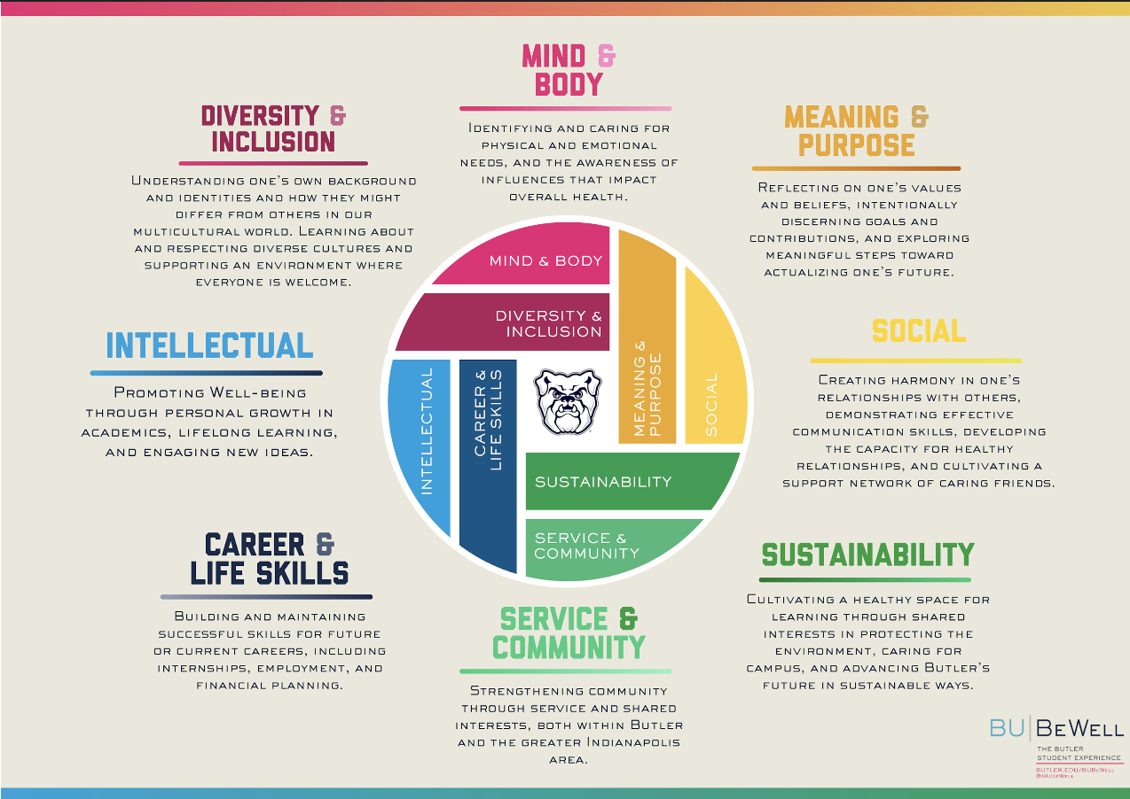
Notes:
Read through each as you click on the dimension

Slide 6
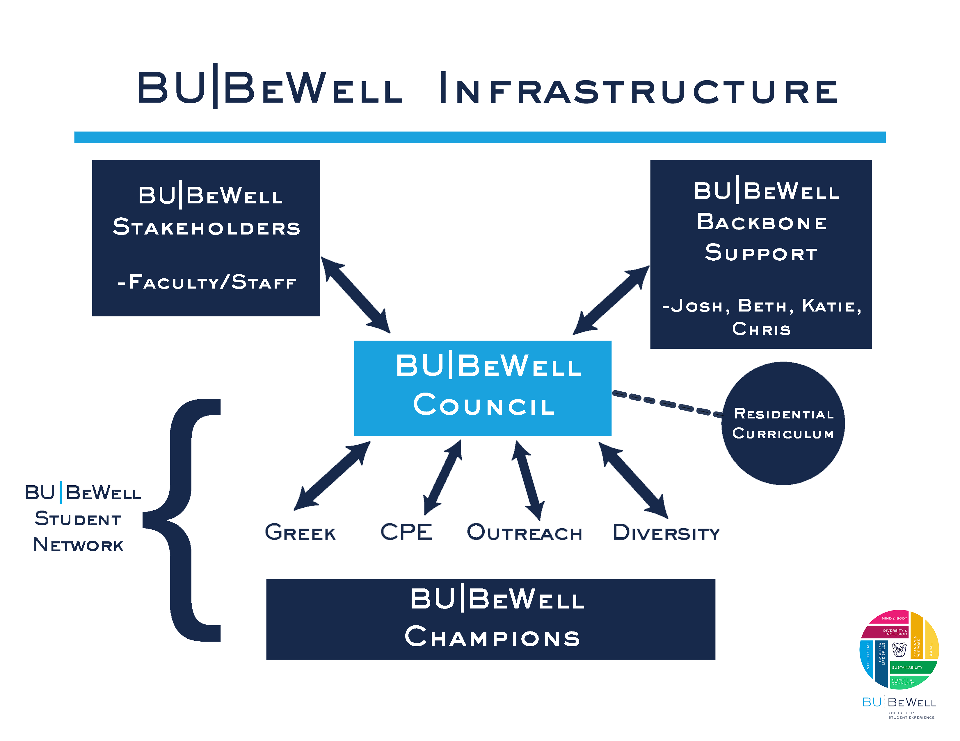
Notes:
This is how we deliver

Slide 7
BUBeWell is for???
EVERYONE
Notes:
Cultural Relevance

Slide 8
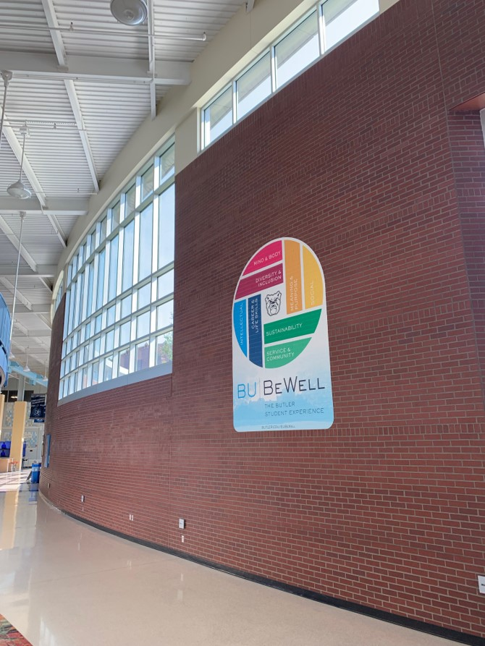

Notes:
So when you see it on campus, what should you think?

Slide 9
What does BUBeWell mean for you PERSONALLY?
100%
Notes:
It’s a momen to stop and reflect – Butler cares about us. Am I okay? What do I need? Use resources
It’s not to be 100% “well” in every dimension. Example of being okay not being at 100% of one type of wellness. Use physical activity and we’re in a pandemic.

Slide 10
What does BUBeWell mean for you PROFESSIONALLY?
RESOURCES
Supporting students and fellow faculty and staff members
Notes:
When you see it, what does it mean for you as a professional at the University? Resources for you to know and help others (I’ll show you where they are in a second).

Slide 11
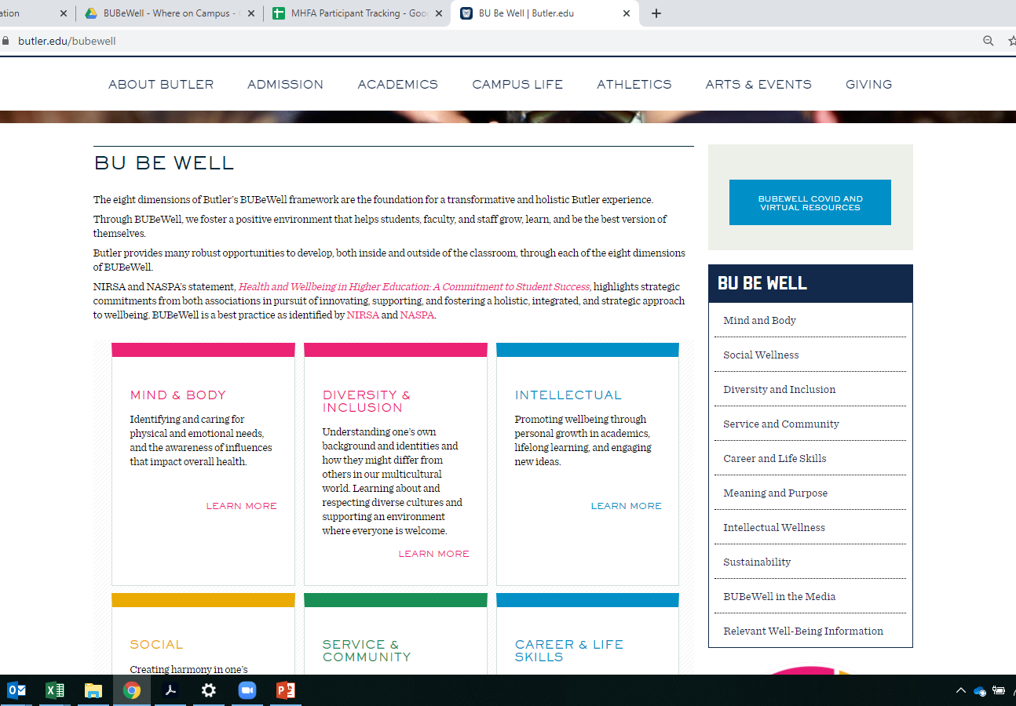
www.butler.edu/bubewell
Notes:
The website – also virtual resources too.

Slide 12
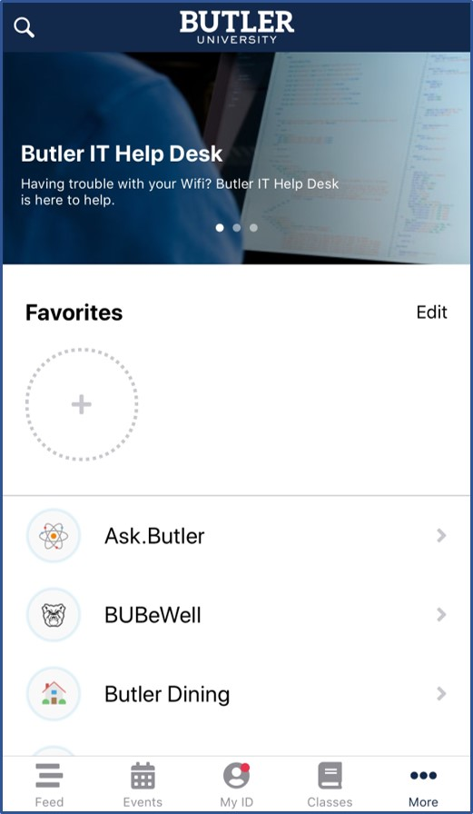
The Butler App
Notes:
The App – it will take you to the website.

Slide 13

Listen
And…
Offer Resources
Notes:
So listen to students and colleagues and offer to help them find a resource. You don’t have to have an answer or be the resource.

Slide 14
CHALLENGE
Notes:
My challenge to you? What are you going to do differently today? Notice and reflect when you see the framework – am I okay?, reach out to a colleague or student and ask how they are?, look up the resources we mentioned?

Slide 15
www.butler.edu/bubewell bubewell@butler.edu
@BUBeWell (Instagram)
#BUBeWell
Thank you!

