Slide 1
Welcome to Butler Libraries
Sally Neal, Assoc. Dean
11/16/2022

Slide 2
Plan for today:
Talk about Physical Spaces
Talk about Human Resources
Talk about Electronic Resources
QuickMeme. http://www.quickmeme.com/meme/3tyd47, Accessed 11/11/2022.

Slide 3
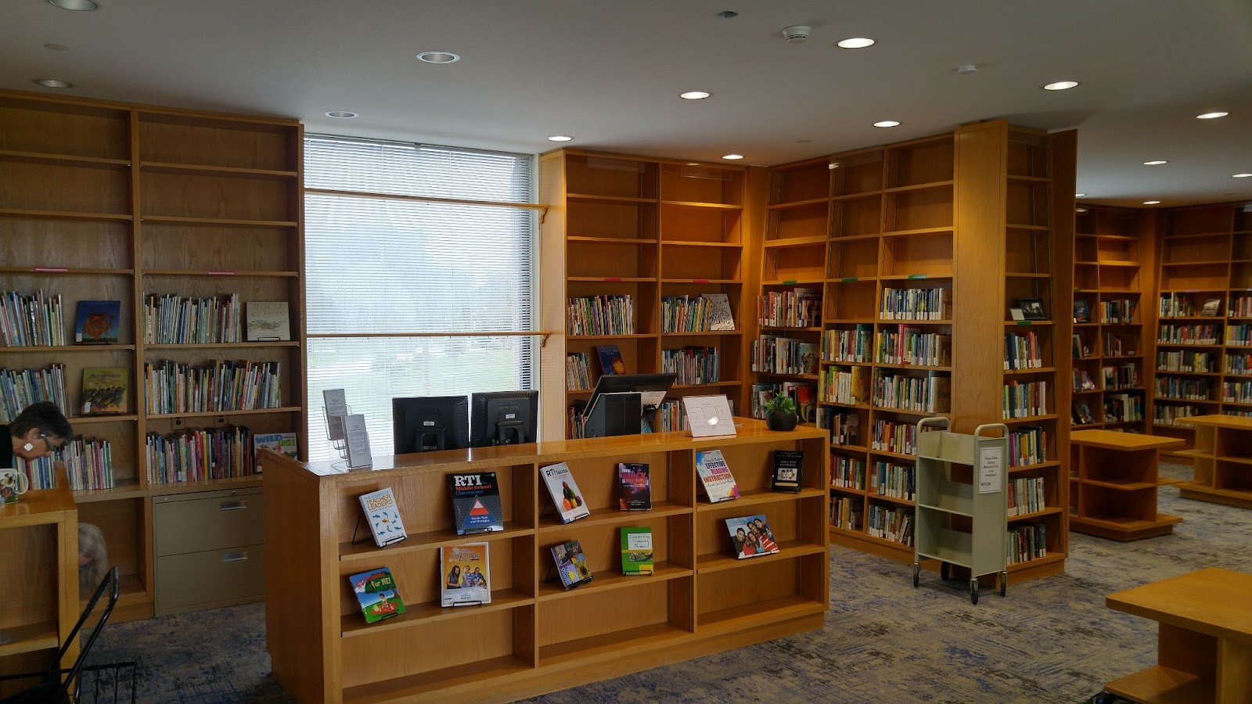
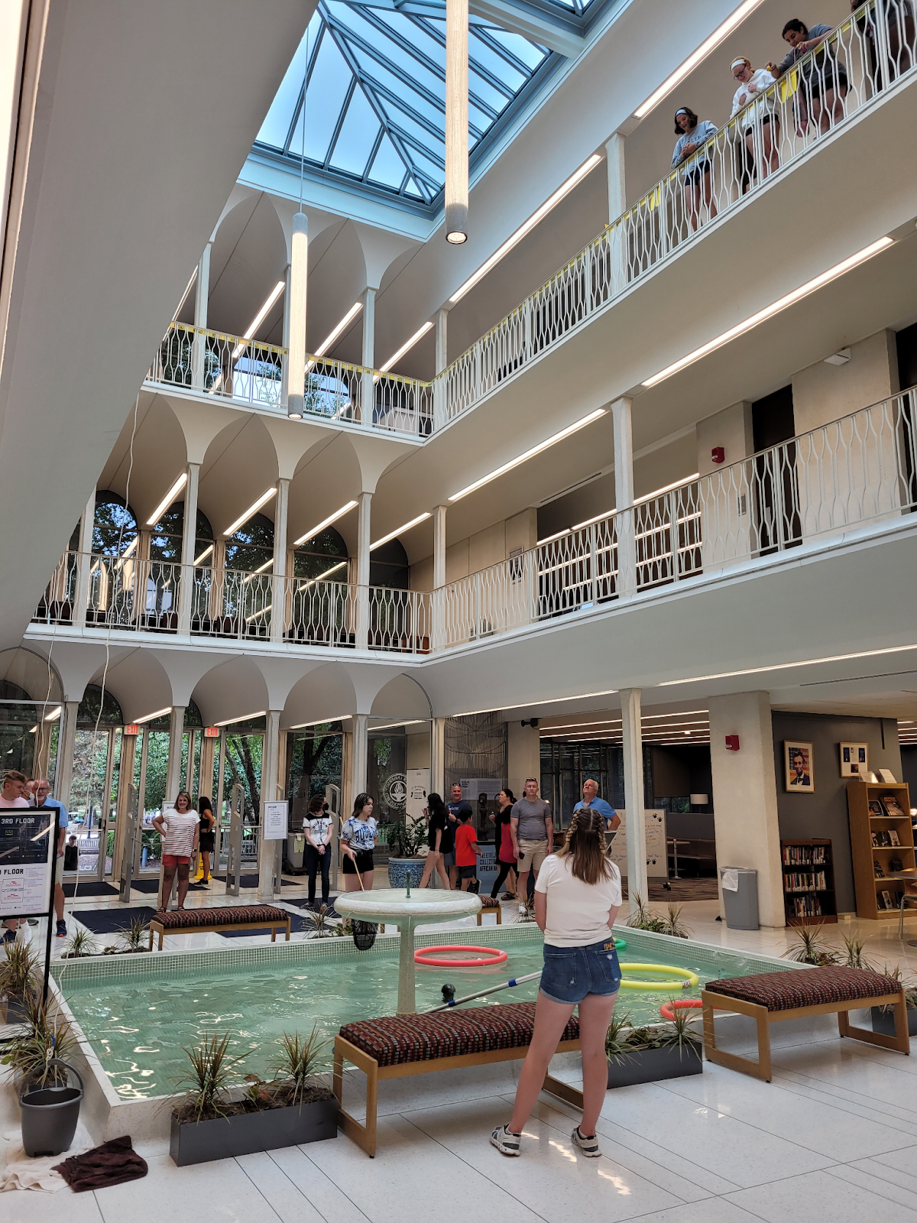
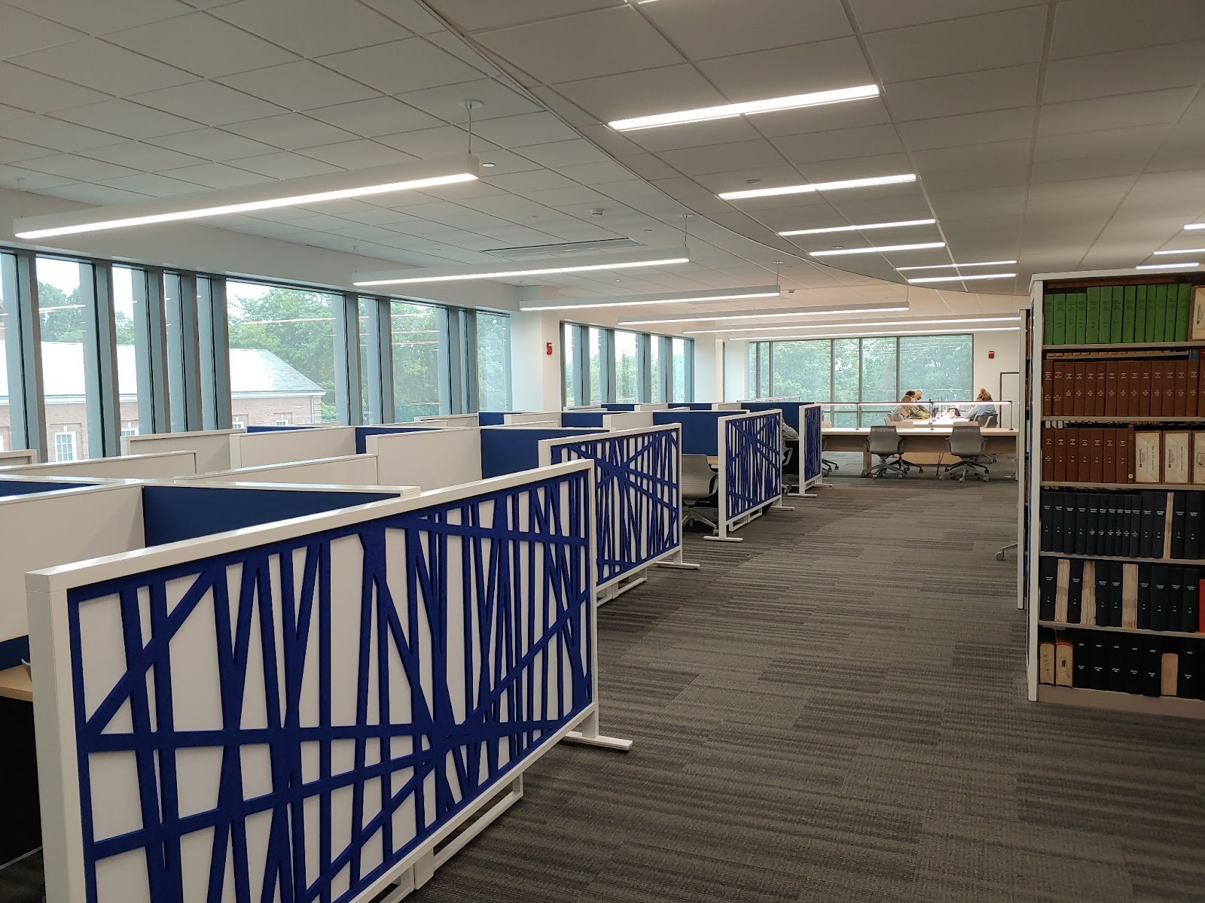
Location, Location, Location
Education Resource Library
Science Library
Irwin Library

Slide 4
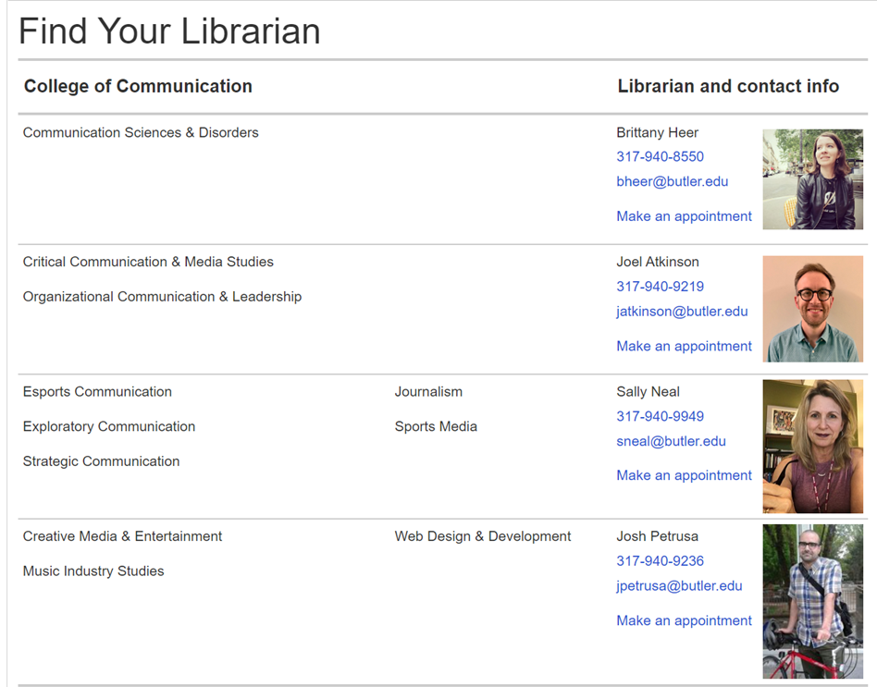
People! Subject Librarians

Slide 5
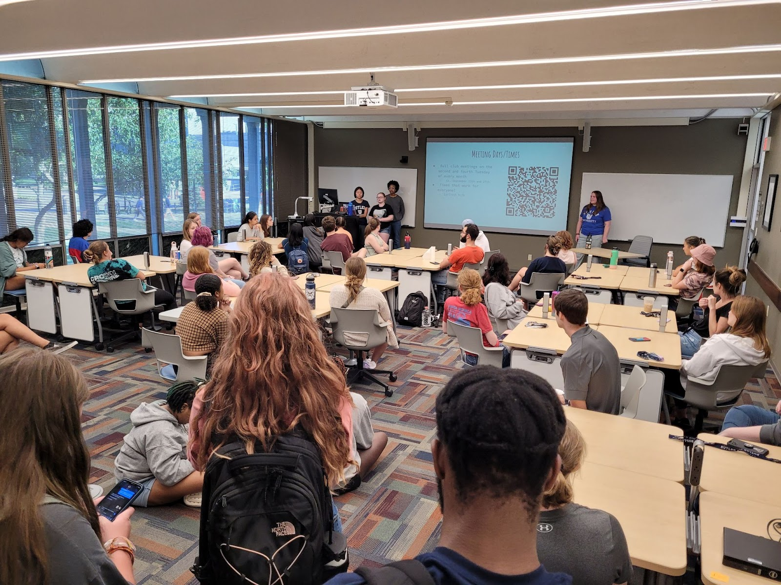
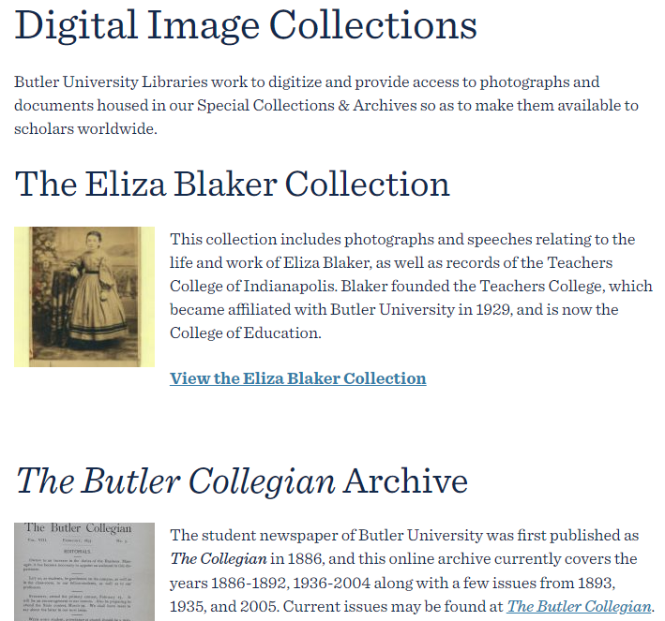
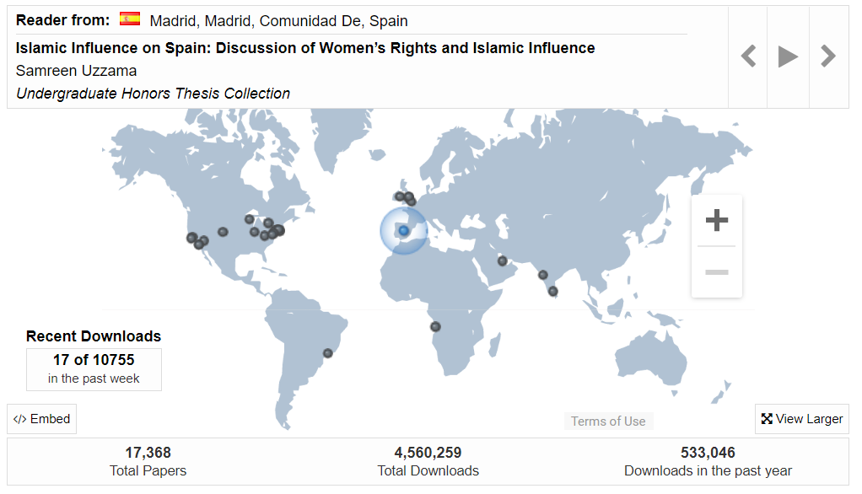
What we do….
Teach
Digitization
Collections
Scholarly Communication
Notes:
What is Research? https://lib-guides.letu.edu/globalstudents, LeTourneau University. Accessed

Slide 6
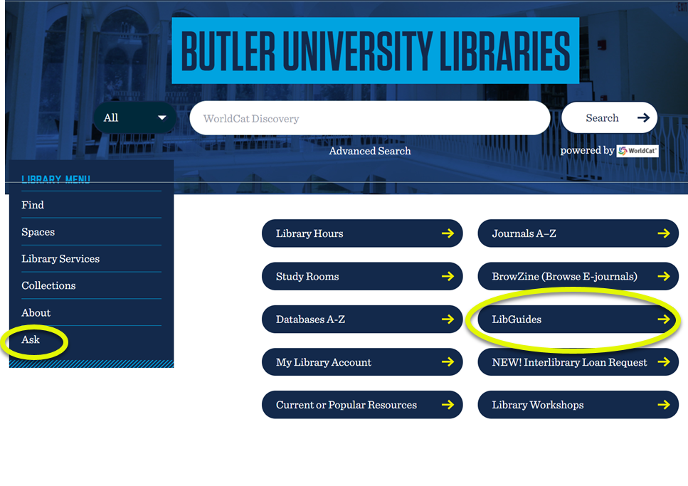
Electronic Front Door
THE CATALOG
Databases
LibGuides
ASK

Slide 7
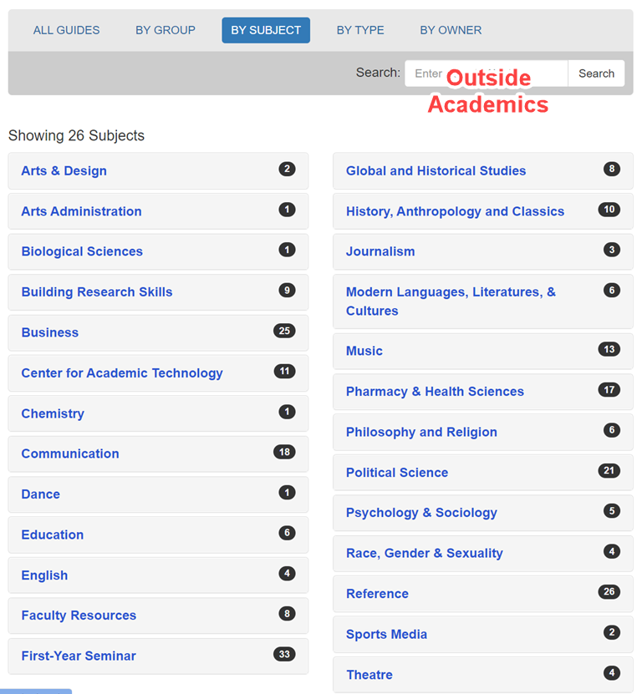
LibGuide Landing Page
https://libguides.butler.edu/ outside-academics

