Slide 1
Butler Staff Assembly Blood Drive Kristine Pierce Regional Manager, Donor Recruitment 1/18/2023

Slide 2
Our Mission: Be the beacon. Save lives. Expand the frontiers of patient health.
We’re on a mission of service—to improve patient outcomes; to advance the field of personalized medicine; and to strengthen to health of communities everywhere.
We make discoveries that contribute to better patient care. And we are a beacon of hope, care, and innovation in the communities we call home.

Slide 3
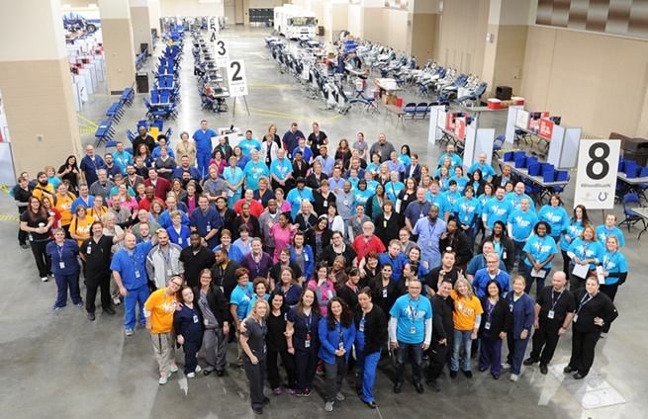
Versiti Blood Center of Indiana
A vital link in Indiana’s healthcare infrastructure
Collects more than 500 units of RBCs daily
350 employees run over 3000 blood drives
6 donor centers across Indiana
Licensed: US FDA, European Union Regulatory Agency, and multiple state departments of health agencies
Inspired by 90K+ volunteer blood donors every
Serves 90 hospitals across Indiana
Non-profit community service organization

Slide 4
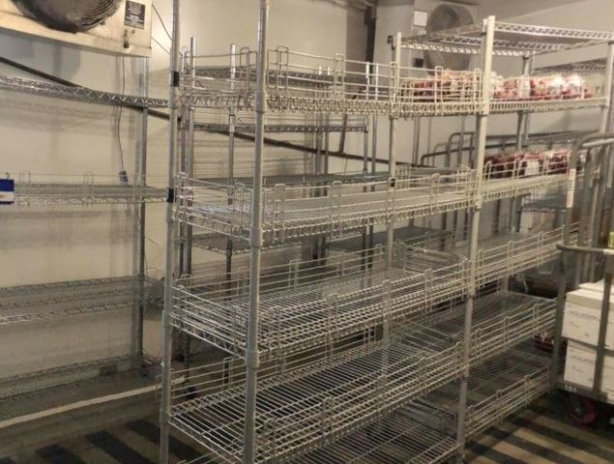
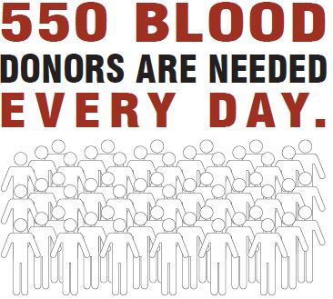
The Need Is Daily

Slide 6
Blood Competition
The goal is to collect 1000 blood products between the two competing schools between September 1, 2022 and April 15, 2023.
The scoreboard can be viewed at Versiti.org/butler, only with links for Butler drives.

Slide 7
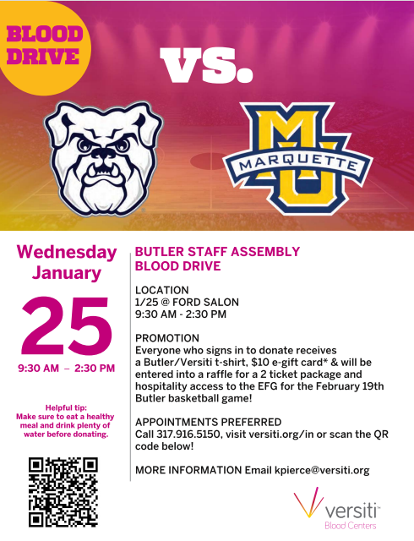
Staff Assembly Blood Drive
Please join us in this room between 9:30am and 2:30pm on Wednesday, 1/25.
Please eat a good meal prior to donating
Please be well hydrated
Please bring photo I.D. (state issued)
Please don’t skip any meals prior to donating
Please have a list of medications with dosage amount

Slide 8
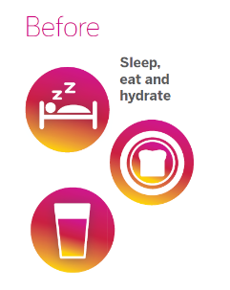
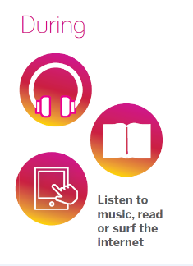
Helpful hints to donating blood

Slide 9
Who are you helping when you donate blood?

Slide 10
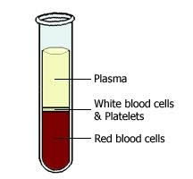
What is blood made of?
Platelets
Cancer patients could require one unit of platelets each day during chemotherapy.
Platelets can be donated every 2 weeks.
Red Blood Cells and Whole Blood
A trauma patient could use up to 100 units of red blood cells.
Whole blood cells can be donated every 8 weeks. In comparison to double red cells every 16 weeks.
Plasma
A patient with hemophilia could use 1200 units of plasma in their lifetime.
Plasma can be donated every 4 weeks.
Notes:
https://www.ncbi.nlm.nih.gov/books/NBK2263/ (image address)

Slide 11
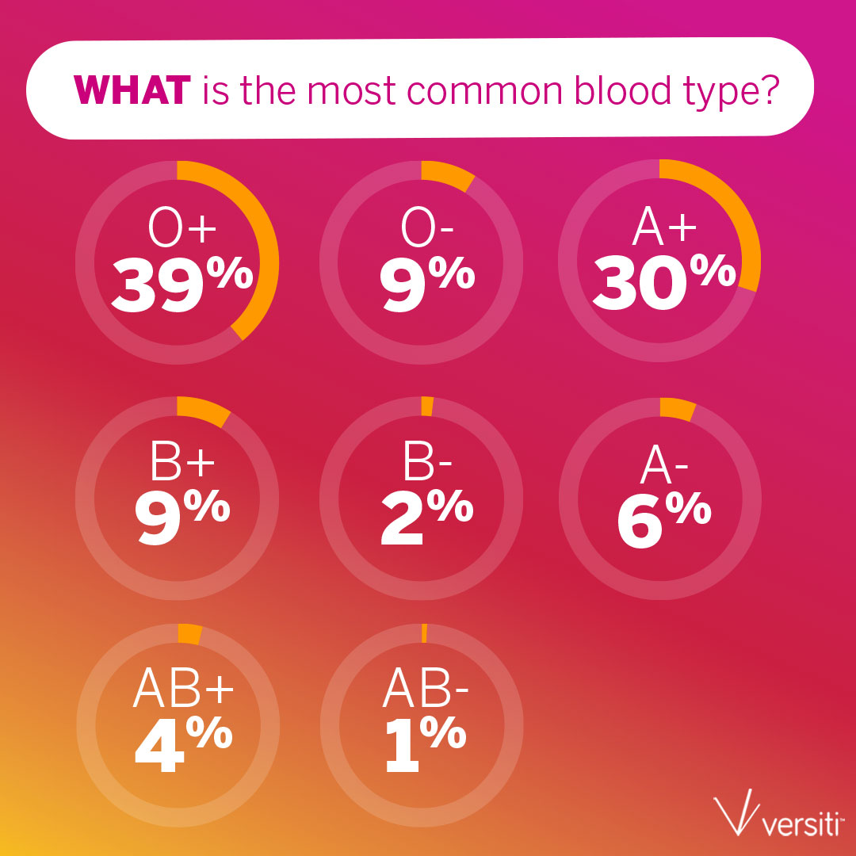
Do you know….

Slide 12
More Than Blood Type
Besides A, B, O, AB blood types, one particular combination of blood group proteins can be life-saving for people with Sickle Cell disease, it’s called R_{o}
This blood type is normal, but uncommon in most donors
Like all blood types, it is inherited
Only 4% of the blood donor base carries this type
44% of African Americans have the R_{o} blood type
17% of Hispanic Americans have the R_{o} blood type
R_{o}
Notes:
Ro donors have distinctive markers on your red blood cells, making their blood invaluable for certain patients. As an Ro donor, you are special, you serve a unique need, and you have the extraordinary power to save the lives of patients in your community, especially patients with sickle cell disease.
There are a total of 52 possible markers
Having Ro blood does NOT mean you have or are at risk for sickle cell disease

Slide 13
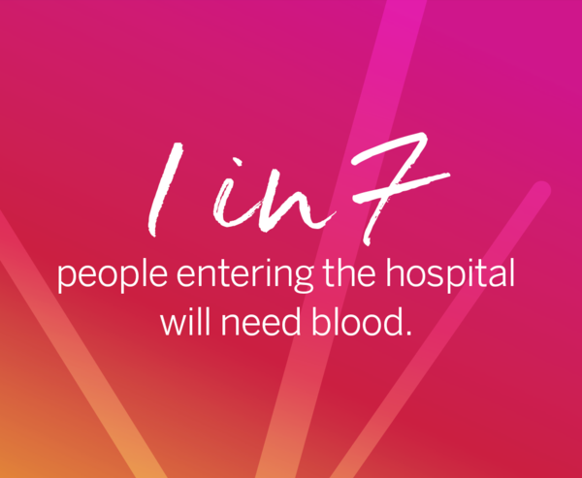
The Need for Blood is Constant
Every 2 seconds, someone in the US needs blood
38% of the population is eligible to donate, yet only 4% do
Red blood cells last 42 days, and platelets only 5 days
We rely on healthy volunteer donors for blood – no way to manufacture blood in a lab or a factory
Aging, shrinking donor base adding to challenges

Slide 14
Questions?

Slide 15
Versiti Blood Center of Indiana Thanks You!

