Slide 1
Staff Benefits

Slide 2
Relationship to BUBeWell
Notes:
Recreation and Wellness is a part of BUBeWell offering physical activity options for well-being that depending on the person fit into many of the dimensions of wellbeing under BUBeWell

Slide 3
Full-time Staff Benefits at HRC
Annual Membership
Free for full-time employees started January 2020
Full time employees have an active membership linked to their Butler ID
Personal Training Discount
All services listed in this section are for full-time faculty and staff only, spouse, domestic partners, and dependents are not eligible.
Notes:
Group fitness is included with membership

Slide 4
Full-time Staff Benefits at HRC
Additional Family Members (16+ years old):
Annual: $300
3-Month: $80
1-Month: $30
Locker Pricing
Full: $60 annual
Half: $30 annual

Slide 5
Part-time Staff Benefits at HRC
Open Track Usage
6:00-8:00 am
12:00-1:00 pm
4:00-5:00 pm
Check the group fitness schedule for noon classes free for faculty and staff (regardless of membership)

Slide 6
Part-time Staff Benefits at HRC
Butler Part-time Employees:
Annual: $250
3-Month: $100
1-Month: $35
Day Pass: $3 (single use and 10 pack available)
Locker Pricing
Full: $60 annual
Half: $30 annual

Slide 7
Personal Training Benefit at HRC
Personal Training Fitness Assessment
Butler Employee Rate: $15
60-Minute Personal Training Session
Butler Employee Rate: $20
Notes:
For faculty and staff regardless of full-time or part-time status

Slide 8
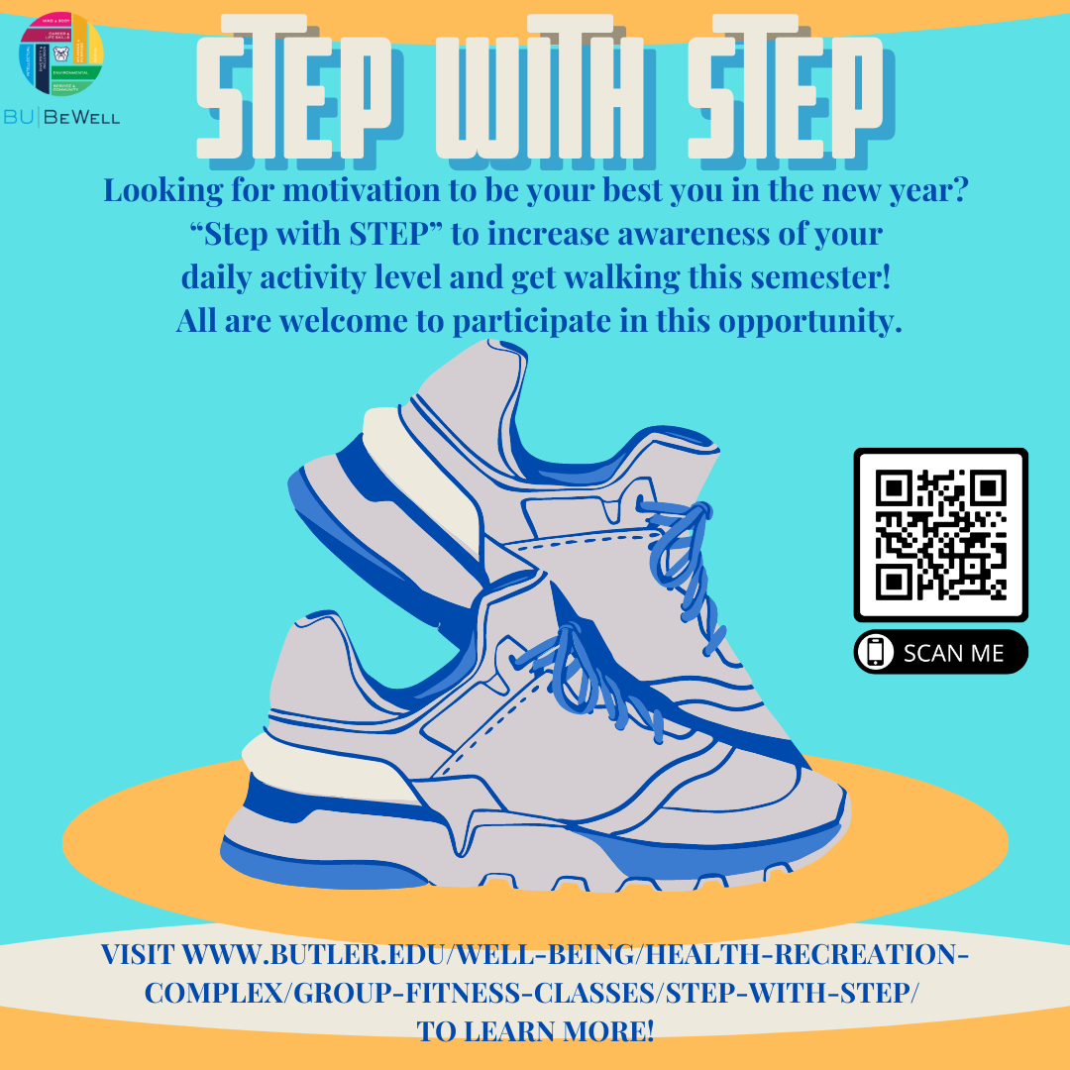
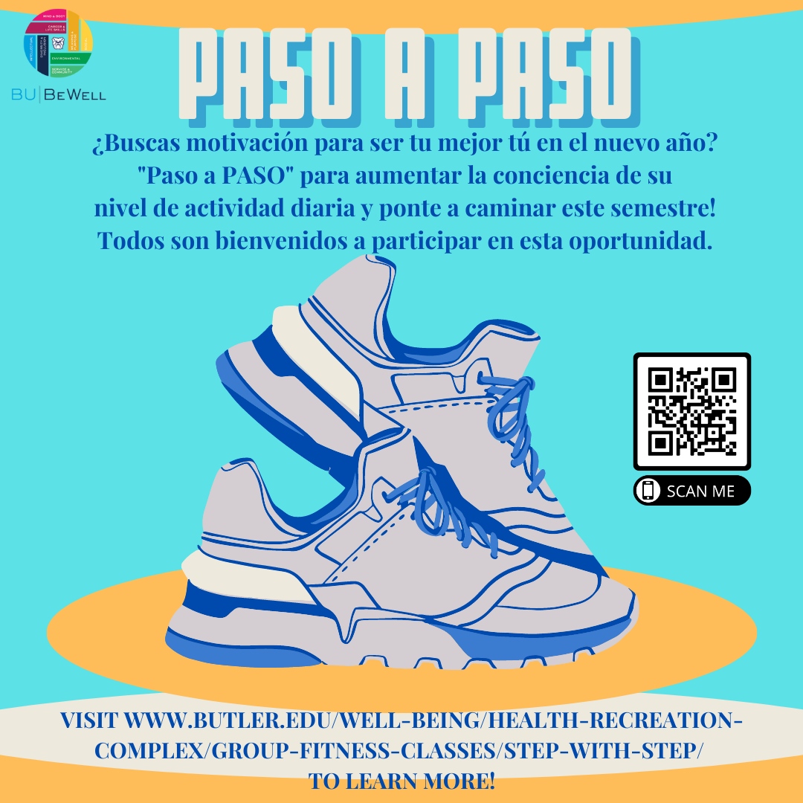
Notes:
Registration is open January 17 - 31 and step counting runs February 1 - March 31.
There are prizes, team options, alternatives to step if that form does not work for you, many ways to count steps. See website for more info.

