Slide 1
Student Employment
January 2023

Slide 2
In any given semester roughly 25% of Butler students work
Over 60 Departments and Organizations on Campus Hire Student Workers

Slide 3
Each Department/Organization is responsible for hiring its own student workers. Student Employment approves the new hires and process the New Hire paperwork.
Handshake and word of mouth are the primary ways that student workers are hired. (CaPS can help Career@butler.edu)
During Welcome Week, the “Get Hired! Job Fair” turns out several hundred students and a few dozen large campus employers as well as Federal Work Study Community Service Partners.

Slide 4
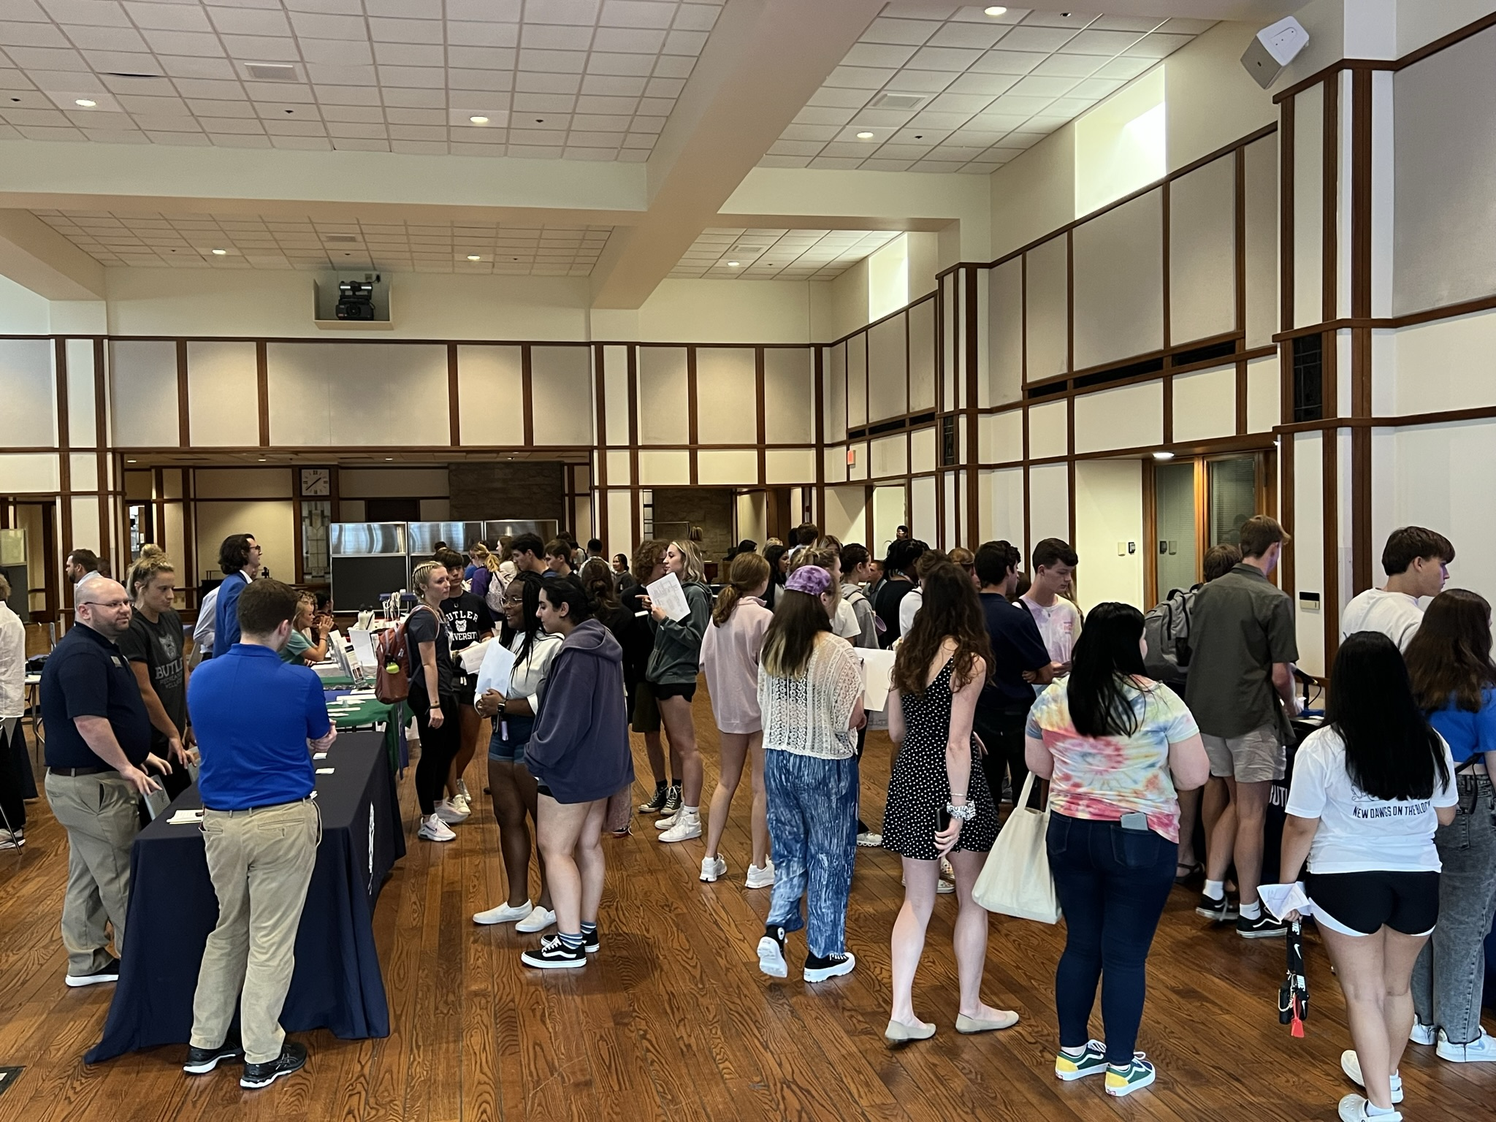
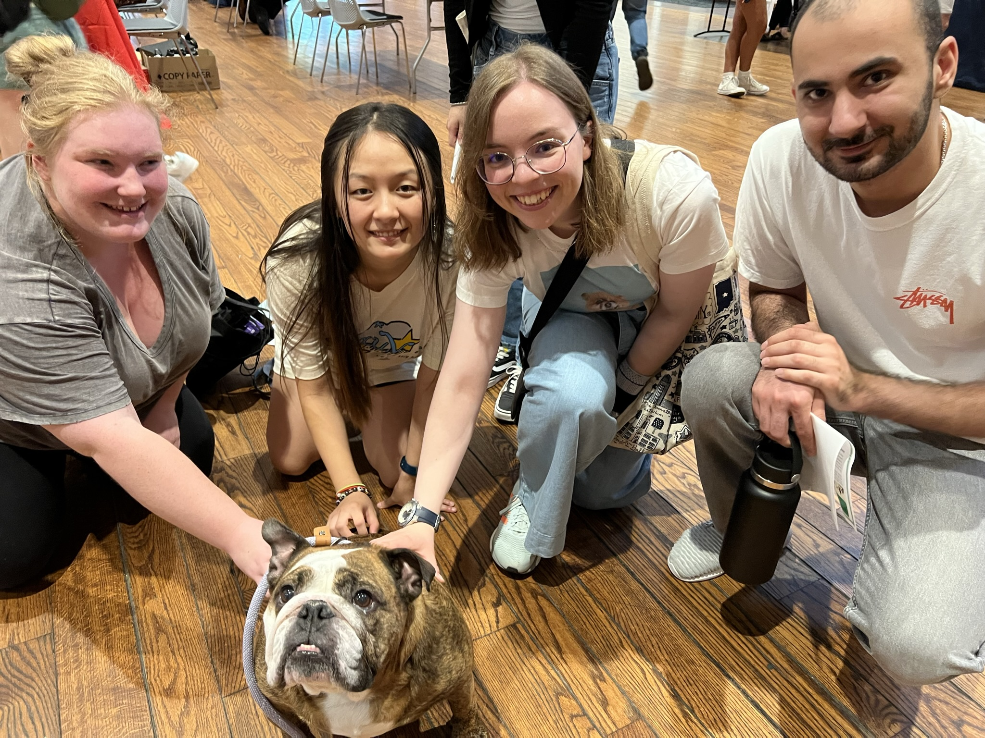
Get Hired! On Campus Job Fair
2022 Get Hired! Fair

Slide 5
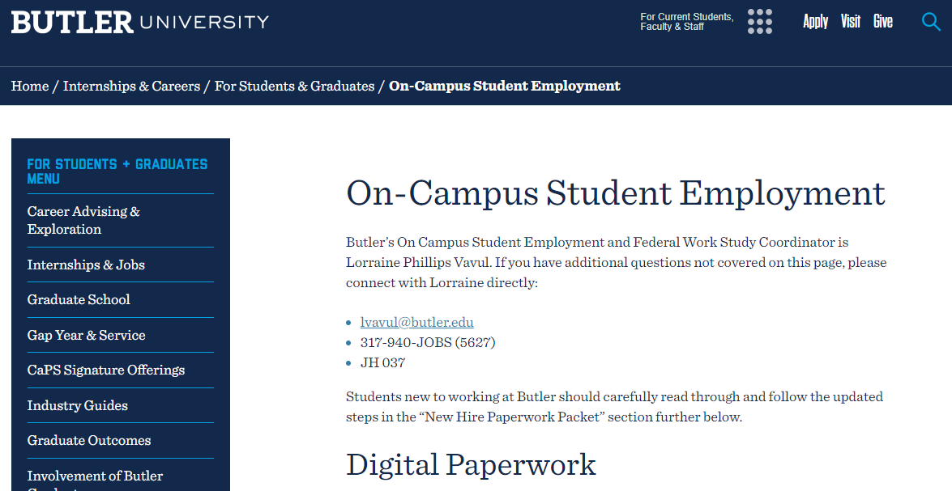
On-Campus Student Employment = Student webpage

Slide 6
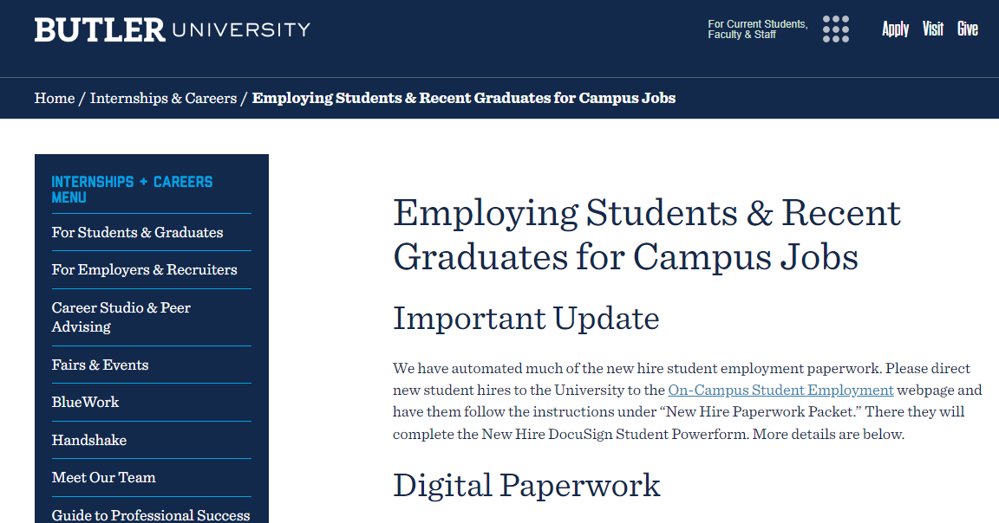
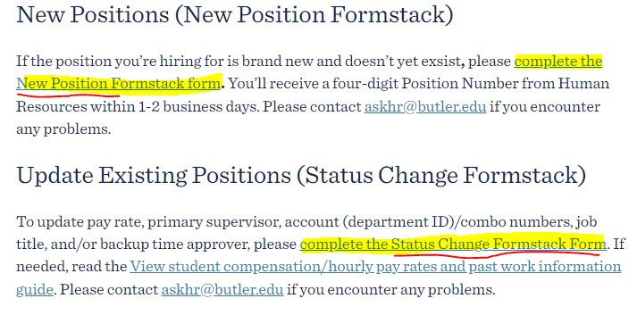
Employing Students & Recent Graduates for Campus Jobs = Supervisor webpage

Slide 7
Once the student accepts the job, please enter them in eHire.
All New Hires to the University must complete new hire paperwork online including the I-9 and present their original, unexpired, signed ID to their supervisor or to HR. Student may start IMMEDIATELY after submitting all info & ID.
Federal Work Study follows the student, so any job on campus is considered FWS.
Terminate your student employees when they graduate or stop working for your area.

Slide 8
I-9 Party
You supply the Color Printer & invite the students and we’ll have an I-9 Party

Slide 9
Source: PeopleSoft, E-Verify, Office of DEI

Slide 10
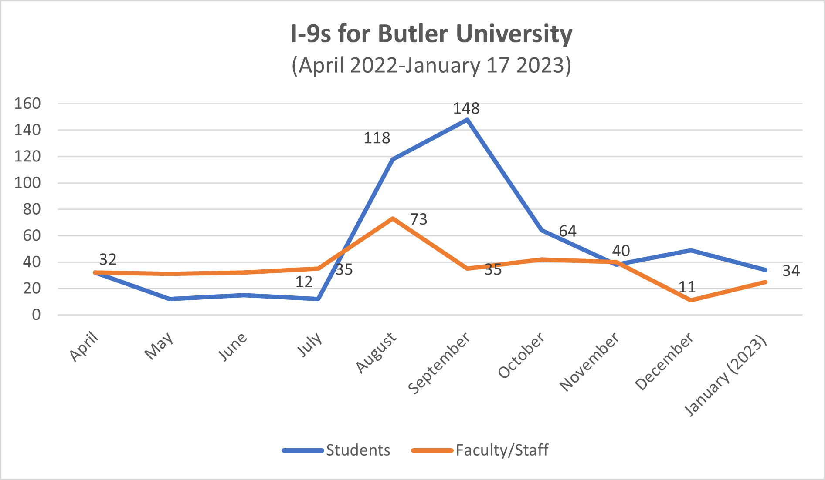
I-9 Student & Staff Completion Trends
Source: E-Verify

Slide 11
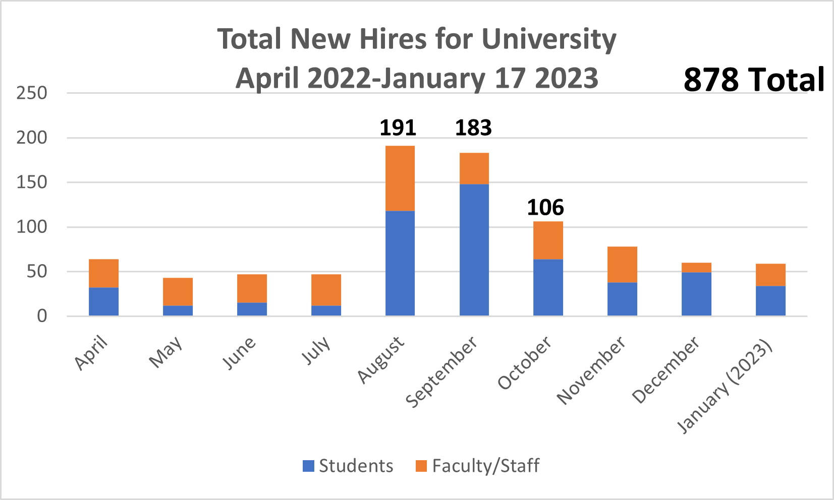
Total New Hires completing I-9
Source: E-Verify

Slide 12
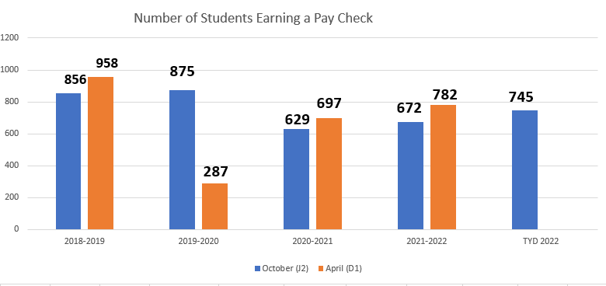
Source: Butler Payroll Department

Slide 13
Source: Peoplesoft

Slide 14
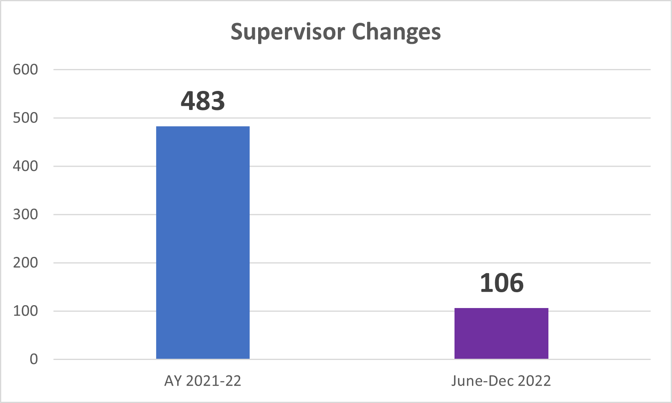
Source: PeopleSoft

Slide 15
Student Employee of the Year Awards
Student Employee of the Year
Student Employee Leadership Award
Outstanding New Student Employee
Coming Spring 2023

Slide 16
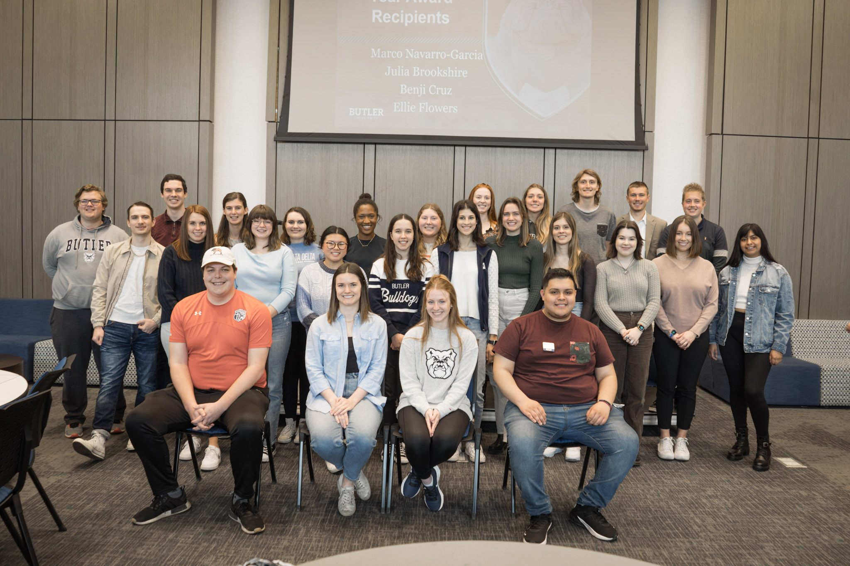
Are you interested in being involved with Celebrating our Student Employees
Judges
Awards Event Committee
Student Recognition Week
Contact Lorraine Vavul to volunteer

Slide 17
Questions
Lorraine Vavul
Student Employment & Federal Work Study Coordinator
Jordan Hall Room 037 317.940.JOBS (5627) LVAVUL@BUTLER.EDU

Slide 19
Student Pay
Minimum Wage is $7.25
Jobs on campus pay between $7.25/hour and $15/hour
In Fall 2022 we have seen pay rates rise among student jobs. Many jobs on campus pay between $9-$11.

