Slide 1
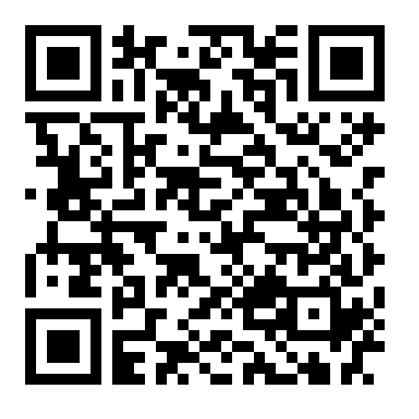
Benefits & Wellness
New Year Updates
Have you seen the Hub?

Slide 2
2024 Benefits
CHECK YOUR DEDUCTIONS
On your first check, please check to ensure all deductions are correct.
Do your premium deductions match your OE elections
Are your HSA and FSA/DCFSA amounts correct for 2024 annual elections
Contact Benefits & Wellness no later than 2/05/24 if you have questions about deductions
benefits@butler.edu

Slide 3
2024 Benefits
ANTHEM CARDS
Have you received all your cards
(one per covered member)
Mailed in early December
In plain white envelope
If you have not received your cards, check your HOME address in my.butler.edu first
Reach out to Benefits & Wellness Team or
Benefits Central Advocacy Team

Slide 4
2024 Benefits
Benefits Central Advocacy Team
If you have questions about:
Billing
Prescription Coverage
Claims
Eligibility
General Benefit Questions
Contact Advocacy Line
Call: 833-856-0111
Text: 317-266-9392
Email: Buadvocate@hylant.com
Contact with Advocate within 24 business hours

Slide 5
2024 Wellness Program
Guide to the NEW wellness program for all full-time faculty and staff.

Slide 6
Butler Wellness
Butler Wellness Mission
Our wellness program's mission is focused on improving your overall physical and mental health and well-being.
While opting for a healthy lifestyle is a personal choice, our wellness program offers resources to make it easier for you to make healthier choices and have access to resources.

Slide 7
Butler Wellness
Change:
Wellness incentive for annual exams will be discontinued as of 2/29/24
Only available to those enrolled in Butler’s medical plan
Introducing:
Wellness Program
Personal Health Coach (on site/virtual)
Fitness and meditation classes
Mental health
Challenges
Health Plans
And more!

Slide 8
Introduction to Spire Wellness
Spire Wellness in partnership with Butler University will provide our faculty and staff with new health and wellness tools and resources.
Spire Wellness is based out of Indianapolis.
Spire Wellness will provide onsite & virtual health coaching, wellness portal, and onsite screening events.

Slide 9
Participant Experience

Slide 10
Participant Experience
Health Risk Assessment
Complete online through Wellness Portal
Annual Wellness Exam with biometrics
PCP or onsite screening event
Attend one onsite or virtual health coaching session
Onsite weekly with Kelly Fenol

Slide 11
Wellness Portal – Intro Email sent by wellness@spirewell.com
We are excited to announce your new wellness program and wellness portal available to all employees. The new wellness portal will give you a better look at your health and provide you with the resources to educate yourself on how you can maintain or improve your lifestyle. Your new wellness portal is part of the Spire Wellness Program and is powered by Preventia.
How to Get Started – Follow these steps
1. Go to https://client.preventiagroup.com
2. Enter Your Email Address
3. Click “Continue”
4. Click “Login”
3. You will be redirected to use Butler SSO for authentication and 2FA requirement
4. On the Landing Page – scroll down to where it says Preventia Wellness Portal
Complete Your Health Risk Assessment
For Support – wellness@spirewell.com or 317-715-1415
If you are looking for health coaching, the onsite health coach will begin on January 26. The health coach will be located at the HRC building in room 154. For more details and the schedule check out the wellness portal.
Please remember that this resource is provided by a third-party vendor that follows all guidelines to protect your privacy. Spire Wellness does not provide any personal health related or personal related info to your employer or any outside party.

Slide 12
Wellness Portal – How to Get Started

Slide 13
Wellness Portal powered by Preventia

Slide 14
Wellness Portal – Health Risk Assessment

Slide 15
2024 Annual Physician Form
Physician Form can be found
Butler Benefits microsite
Wellness Portal
Form due by December 1
Bring or send this form to the doctor’s appointment
Employee completes the top portion and physician completes the bottom half and sends back to Spire Wellness
Butler Benefits Microsite

Slide 16
Wellness Portal – Schedule a Health Coaching Session
Step 1 - Health Coaching Tile
Step 2 – Click on Select a Provider (Kelly Fenol)
Step 3 – Health Coaching (Kelly Fenol)
Onsite Sessions – HRC Room 154
(Weekly 9am-4pm) starting January 26th

Slide 17
Wellness Portal - Extras

Slide 18
Spire Wellness Contact / Need Help
wellness@spirewell.com
317-715-1415

