Slide 1
Butler Giving Circle Grant Process
Staff Assembly March 2024

Slide 2
What is the Butler Giving Circle?
A community of alumni donors dedicated to supporting two mission-critical elements of Butler University’s vision for the future: Student Access and Success and Community Partnerships

Slide 3
Who can Apply for a Giving Circle Grant?
Current Butler students, faculty, and staff engaged with Indianapolis community partnerships may submit project ideas that aim to make a meaningful impact in the organization and in the community.
Grant funds are transferred to and spent by the Butler entity listed on the grant application and cannot be granted to the community partner organization directly. The requesting Butler entity must use funding to support a community impact project in partnership with an Indianapolis organization.

Slide 4
Past Giving Circle Grant Recipients
2023 - COPHS, Pharmacy Practice Department: Butler University Community Outreach Pharmacy
2022 – The Hub for Black Affairs with IPS: Establishing the Youth MLK Oratorical Contest
2021– COE with Partnership for Inquiry Learning: Mentoring Toward Social Justice in Our Schools and Communities
2020–Desmond Tutu Peace Lab: Funding non-violence training for all MLK Center Staff

Slide 5
Learn More & Apply
Grant application (in Butler Today, too):
https://www.surveymonkey.com/r/B6NVDTR
Last year, we were able to award $17,000 to multiple applicants. This year’s deadline to submit a grant application is April 12th.

Slide 6
Selection Process
Grant Applications are Reviewed
Finalists are invited to present their project at the Shareholder Meeting on June 20th
At the Shareholder meeting, members watch the presentations, ask questions, and vote on which project(s) receive the funding.

Slide 7
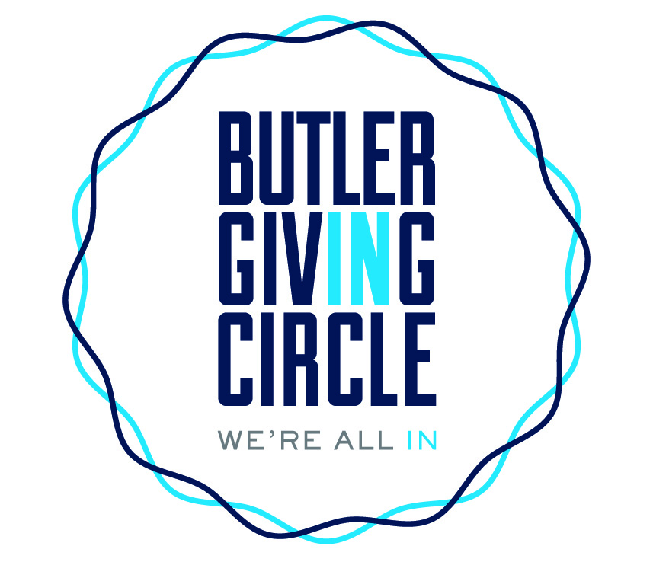
Questions?

