Slide 2
Staff Assembly
March 20, 2024

Slide 3
Objectives
Continue to build awareness of NextUp
Provide a project update
Highlight key HR and Financial process enhancements
Inform you of the Change Network and Training Plan

Slide 4



Why Change? Why Now?
Current Operating Reality

Slide 5




The Vision
To build a foundation for operational excellence upon which Butler will realize its future learning and growth objectives​
Streamlined Processes
Better Access, Better Data
Continuous Improvement

Slide 6




What’s Included
NextUp is Butler University’s HR and Financial systems implementation and operational transformation.
Employee Tools & Information
Financial Tools &
Information
Oracle Cloud
HR/FIN Applications
+ Process Redesign

Slide 7



Project Timeline
Go-live and Realization
(Jan – Mar ’25)
System is live for all transaction processing and post go-live support begins
Transition
(Sept – Dec ’24)
Support training and transition of the Butler community to the new system.
Design & Configure
Current Phase
(Mar ‘23 – April ’24)
Future State Requirements; Functional and Technical Specifications; Configure and Prototype System Functionality; Build and Unit Test Integrations; Develop Business Process Maps
Validate
(May – Aug ’24)
Ensure Oracle Cloud Financials and HCM are Operational.
Initiate & Plan
(Jan – Feb ’23)
Project Scope, Strategy and Framework

Slide 8
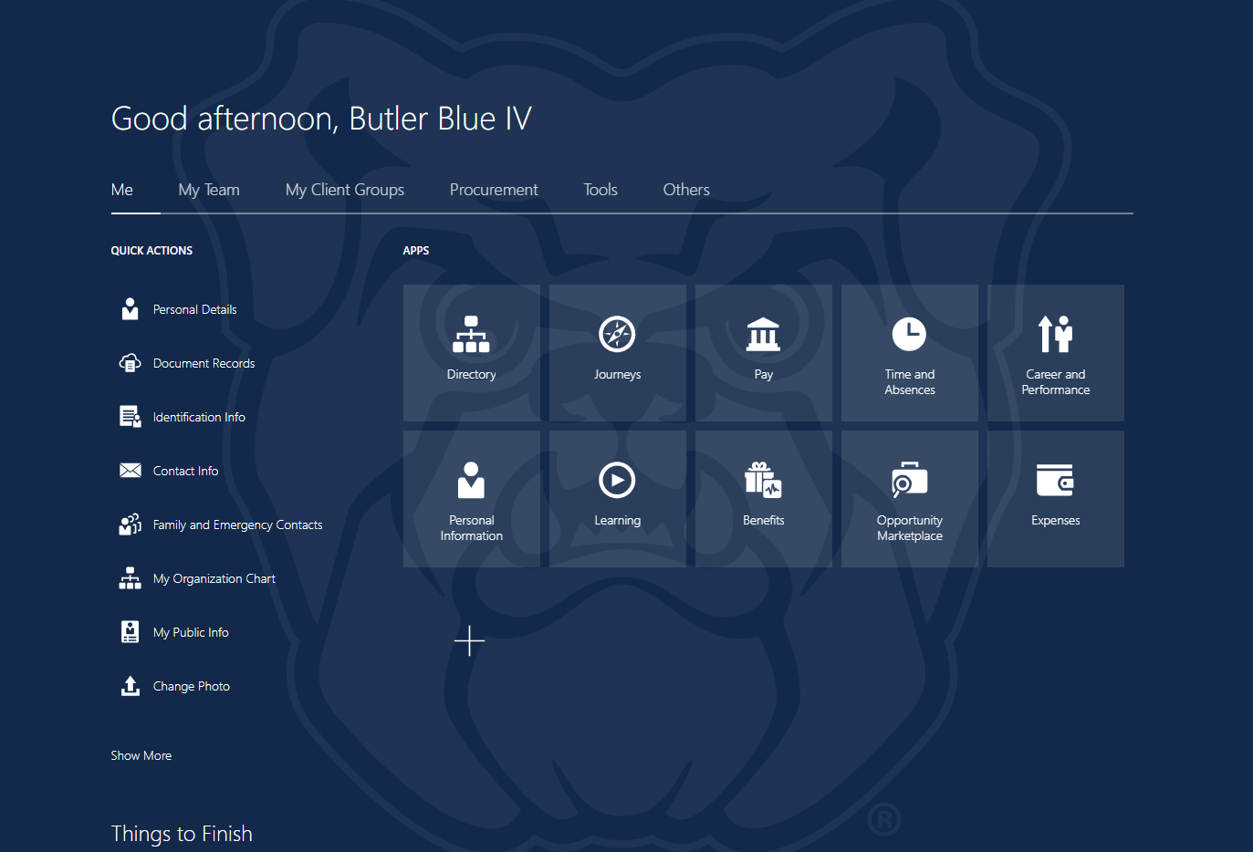
Key Enhancement – Employee Self Service
Employee and financial tools all in one place, accessible on any device!

Slide 9
Key Enhancements – Employee Processes
Recruiting & Hiring – connected applications, an elevated and streamlined experience for candidates and hiring teams
Fewer Forms – more transactions in system; improved accuracy
Access to Information – for self and team members
Supervisor Actions – to make business title and location changes
Performance - check-ins and reviews are completed in system and connected to the merit process
Journeys – collections of tasks to guide team members during their personal and professional transitions

Slide 10
Key Enhancements – Financial Processes
Expense Reporting – connected applications, streamlined experience
Purchase Flexibility – no special role needed to requisition
Purchase Visibility – improved access to view requisition details and workflow; reduces offline trackers
Financial Reporting – on demand for those with designated analyst role; drill-down capability to transaction detail

Slide 11
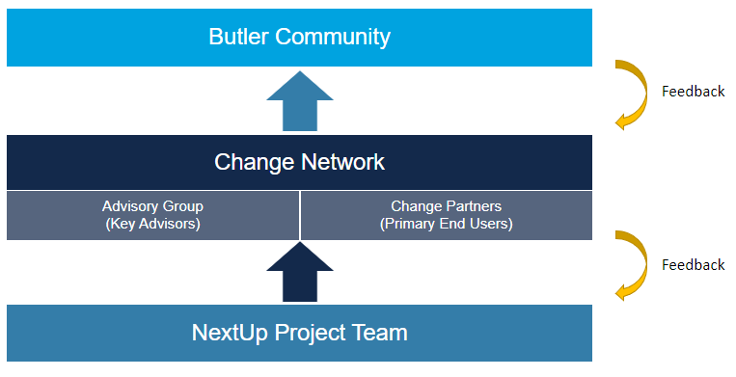
Change Network

Slide 12




Training – What to Expect
Progressive training, timing varies by user type Central Users Now – Dec and beyond for testing & training End User Community Presentations & Demos now through Fall Oct – Dec and beyond for formal training delivery
Many Modalities Instructor-led training Self-paced training Quick Reference Guides Job Aids / Process Guides In-application Guided Learning Open Labs | Review and Update Cycle Informed by training efficacy, evaluations and future system changes

Slide 13
Key Takeaways
This is a unique and exciting opportunity for Butler!
NextUp builds a foundation for operational excellence, critical for achieving our Butler Beyond aspirations.
You can expect many enhancements to Employee and Finance processes, beginning with improved access and visibility of data, as well as an elevated experience.
A campus-wide Change Network will support communication and adoption efforts.
Presentations, communications and demos will ramp up this Spring-Summer. Formal training will be delivered Oct – Dec and beyond go-live.
Our go-live date (when everyone begins working in the new system) is January 1, 2025.
Visit the NextUp website (my.butler.edu/nextup) for more information and to provide feedback.

Slide 14
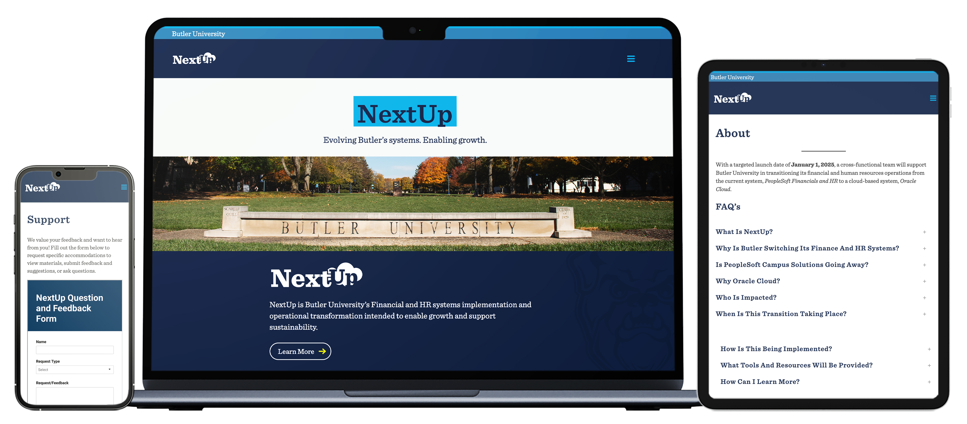
NextUp Website
my.butler.edu/nextup

